Slide 1
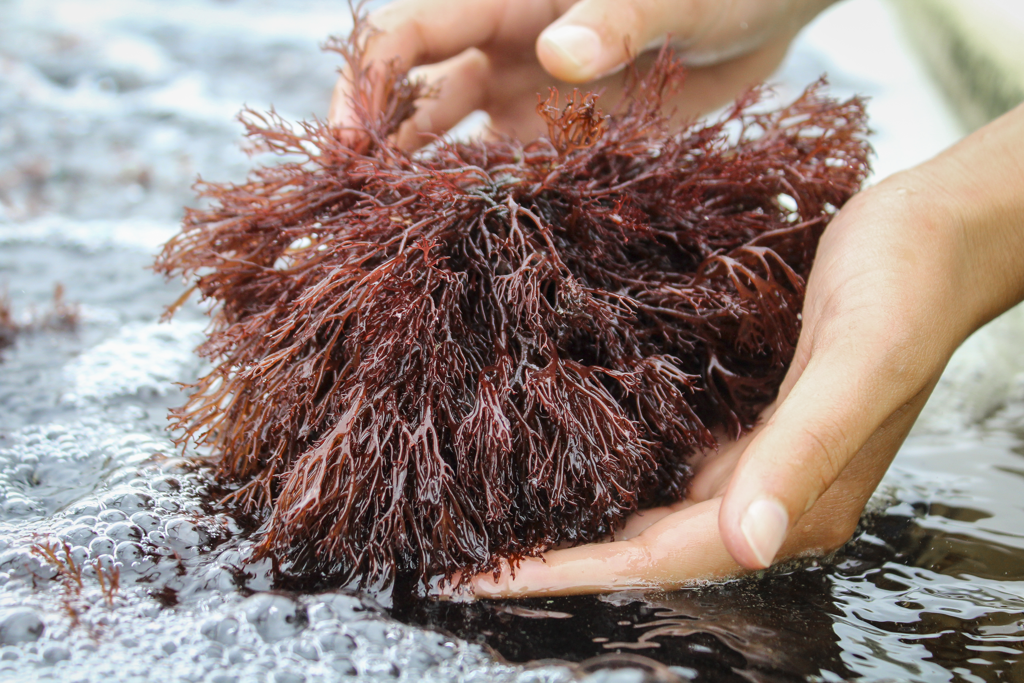
Scoping the potential of seaweed aquaculture in Southern California
Ian, Iwen, Shaun, and Shelby
in conjunction with
Santa Barbara Mariculture
Sustainable Aquaculture Research Center
Notes:
SHAUN AND SHELBY:
Add Bren and SARC and SB Mariculture logo to cover slide
Should spell out SARC but yes may need to reformat above
TALKING POINTS:

Slide 2
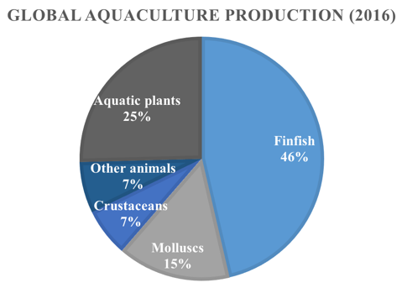
Background: Global Seaweed Aquaculture
Global Seaweed Sector
$6 billion value
80% human consumption
US Seaweed Consumption
+90% imported into the US
West et al., 2016 (FAO)
Notes:
SHAUN AND SHLEBY:
Something to convey the bolded key facts below
TALKING POINTS:
Aquaculture production has been steadily increasing globally, a sector that is not considered as much is seaweed, which takes up 25% of all production
The total market is valued over 6 billion dollars and over 80% of this is utilized for human consumption through direct or processed product.
Demand for seaweed has been increasing in the US (Nayar and Bott 2014, West et al., 2016). There has been some growth in the high-end or niche health food market, but over 90% of the supply is imported
Maine and Hawaii currently produce the greatest amount of domestic supply, but much of it is also exported.
- As our demand continues to grow, our environmental footprint will increase substantially <<<<<<< Need to improve wording here
NOTE: SOMEWHERE ADD IN FOCUS OF FOOD

Slide 3
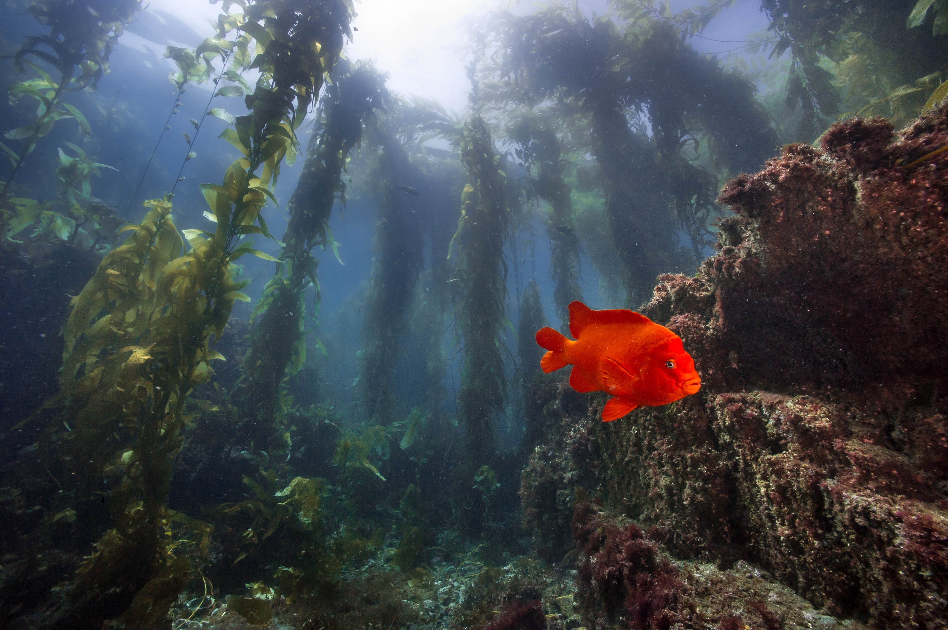
Background: Local & Sustainable
Why Local
Environmental footprint
Ensure sustainable cultivation
Seaweed Ecosystem Role
Buffer for localized changes in ocean conditions
Ocean acidification
Eutrophication
Hypoxia
Gentry et al 2016
Notes:
SHAUN AND SHLEBY:
SOME AWESOME PICTURE REPRESENTING MACROALGAE PRODUCTIVITY OF SOUTHERN CA BIGHT.
Here talking about the environmental motivation for our project, bringing it to the local market discussion, and why it’s more sustainable
Want to give audience a sense of wow seaweed growing super well here in California
I don’t think so, but do you guys think we need a visual slide or picture that pops in before/after this kelp picture that conveys the bolded stuff in speaking points below? Pasted an infographic above maybe not
TALKING POINTS:
To address this, people in the US are starting to talk about increasing local production of seaweed for local consumers
Not only would this reduce the environmental footprint of importing seaweed, but we would be able to ensure that the cultivation practices used are sustainable
Furthermore, there may be added benefits to some of our coastal regions of growing more seaweed locally. As very efficient primary producers, may act as a buffer for local changes in pH, oxygen, CO2, and nutrient <<<<< REWORD
Recent studies have identified The Southern California Bight as a very productive marine environment and particularly suitable for seaweed growth:
Spring upwelling provides a lot of nutrients
Year-round temperate environment may allow certain seaweeds to grow for longer periods as conditions doesn’t fluctuate as drastically as in Japan or Ireland

Slide 4
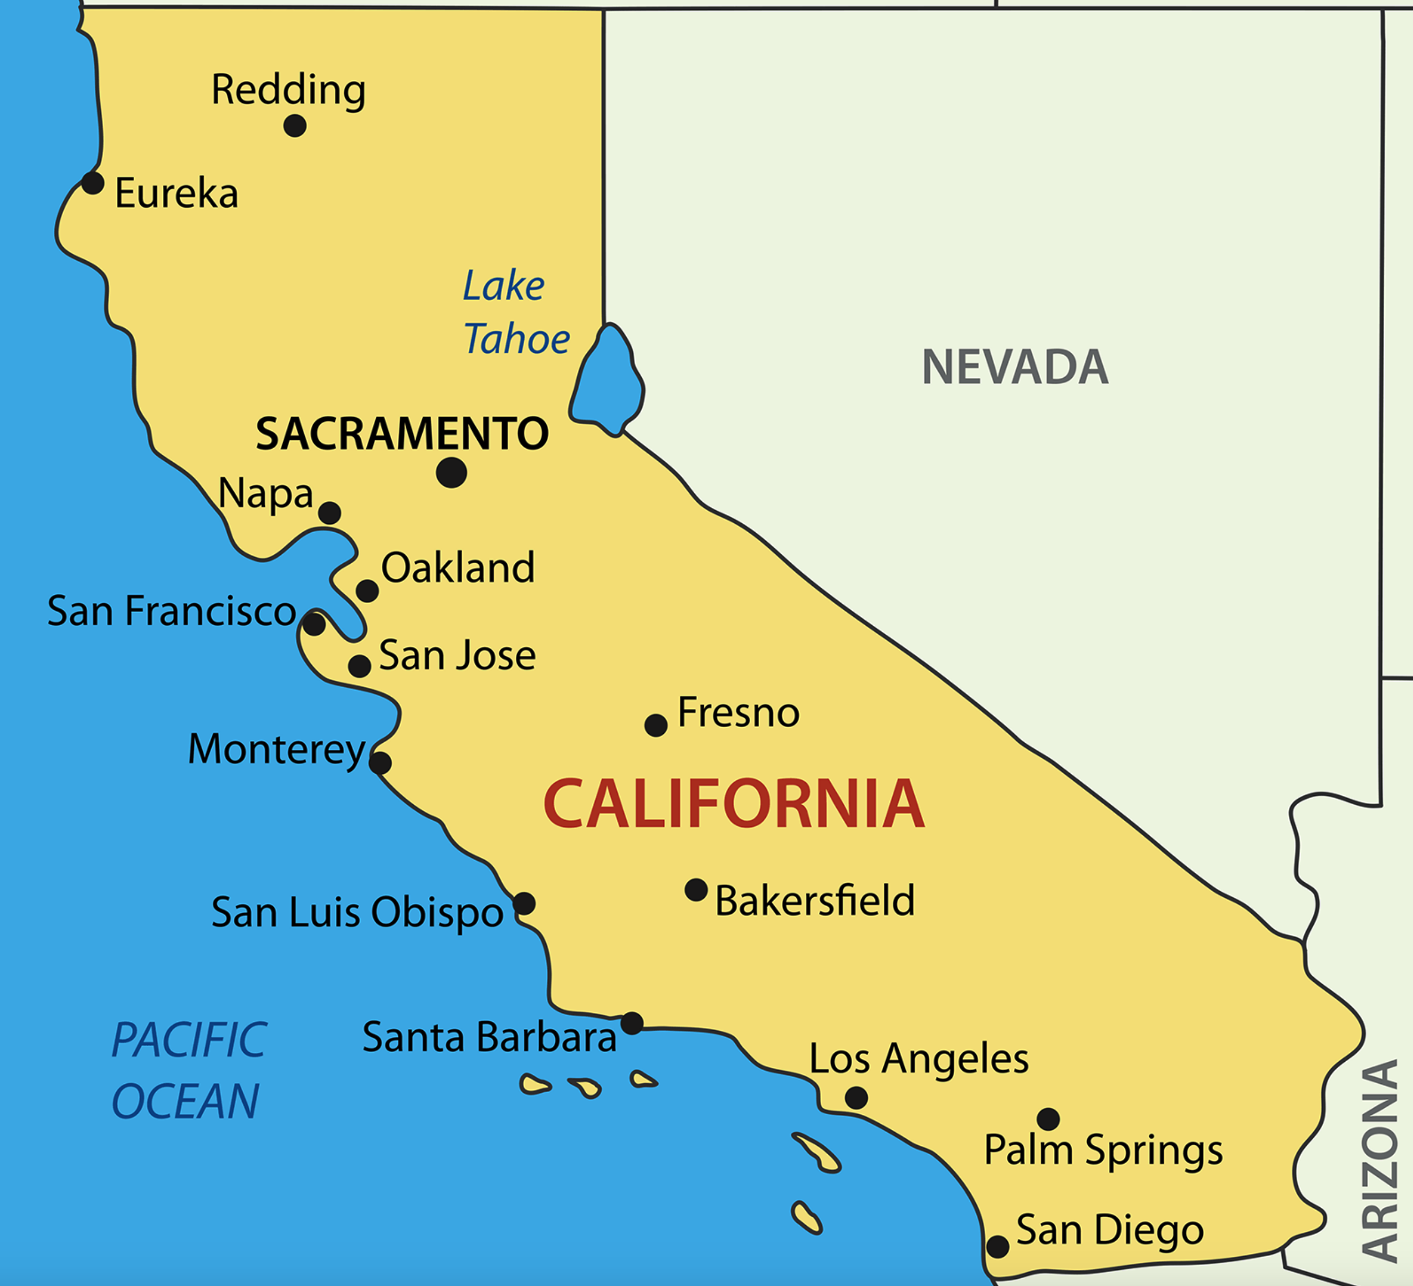
Background: Seaweed in California
Notes:
SHAUN AND SHELBY:
- These two CA slides would be super super super quick …
TALKING POINTS:
- We have a few people wild harvesting and less than a handful growing seaweed in California

Slide 5
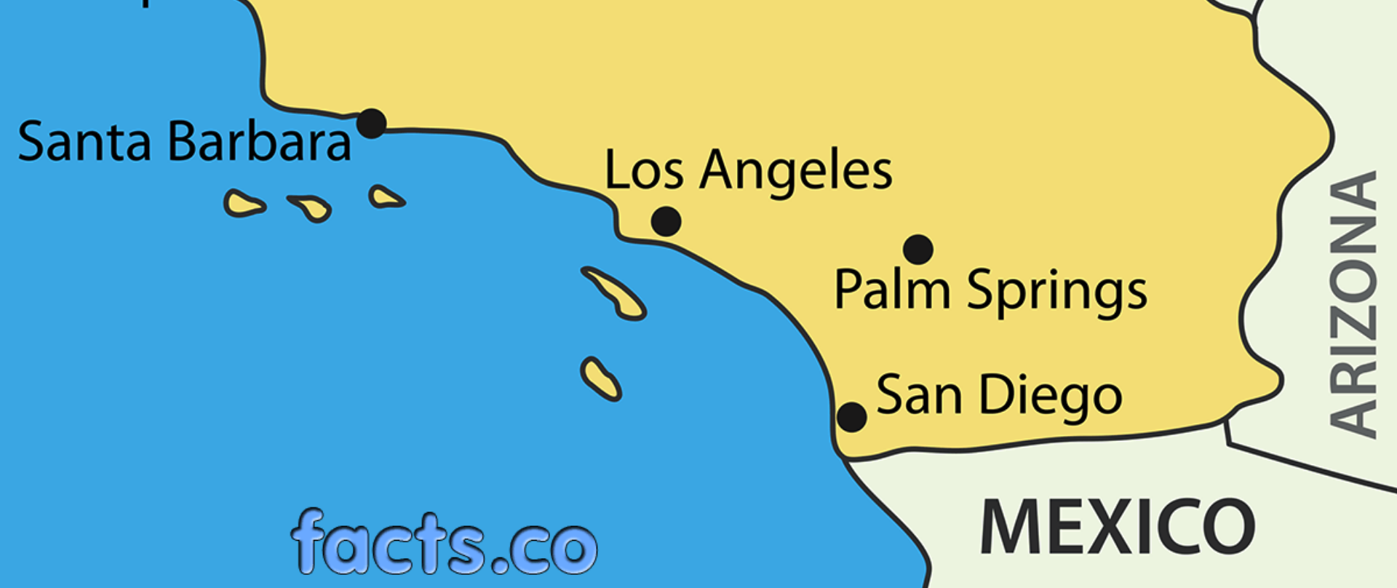


Background: Seaweed in California
= Existing Farms
= Future Farms
Notes:
TALKING POINTS:
- Two of these farms are in southern CA growing it as a supplemental crop to shellfish, there are two newly approved permits for seaweed cultivation offshore, and a couple ports interested in future development

Slide 6
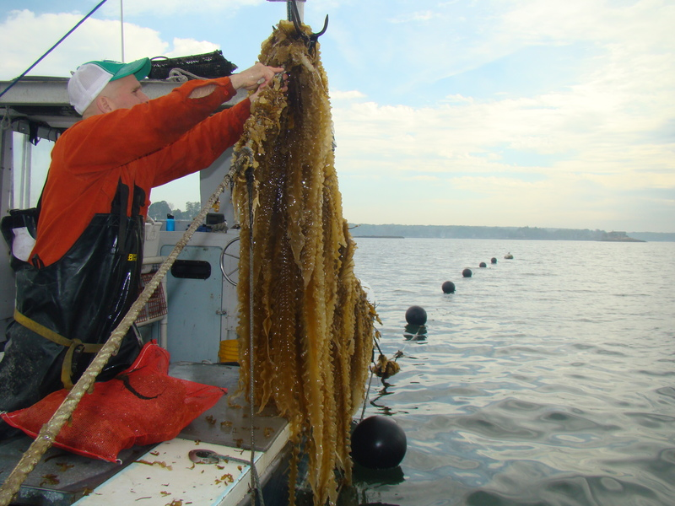
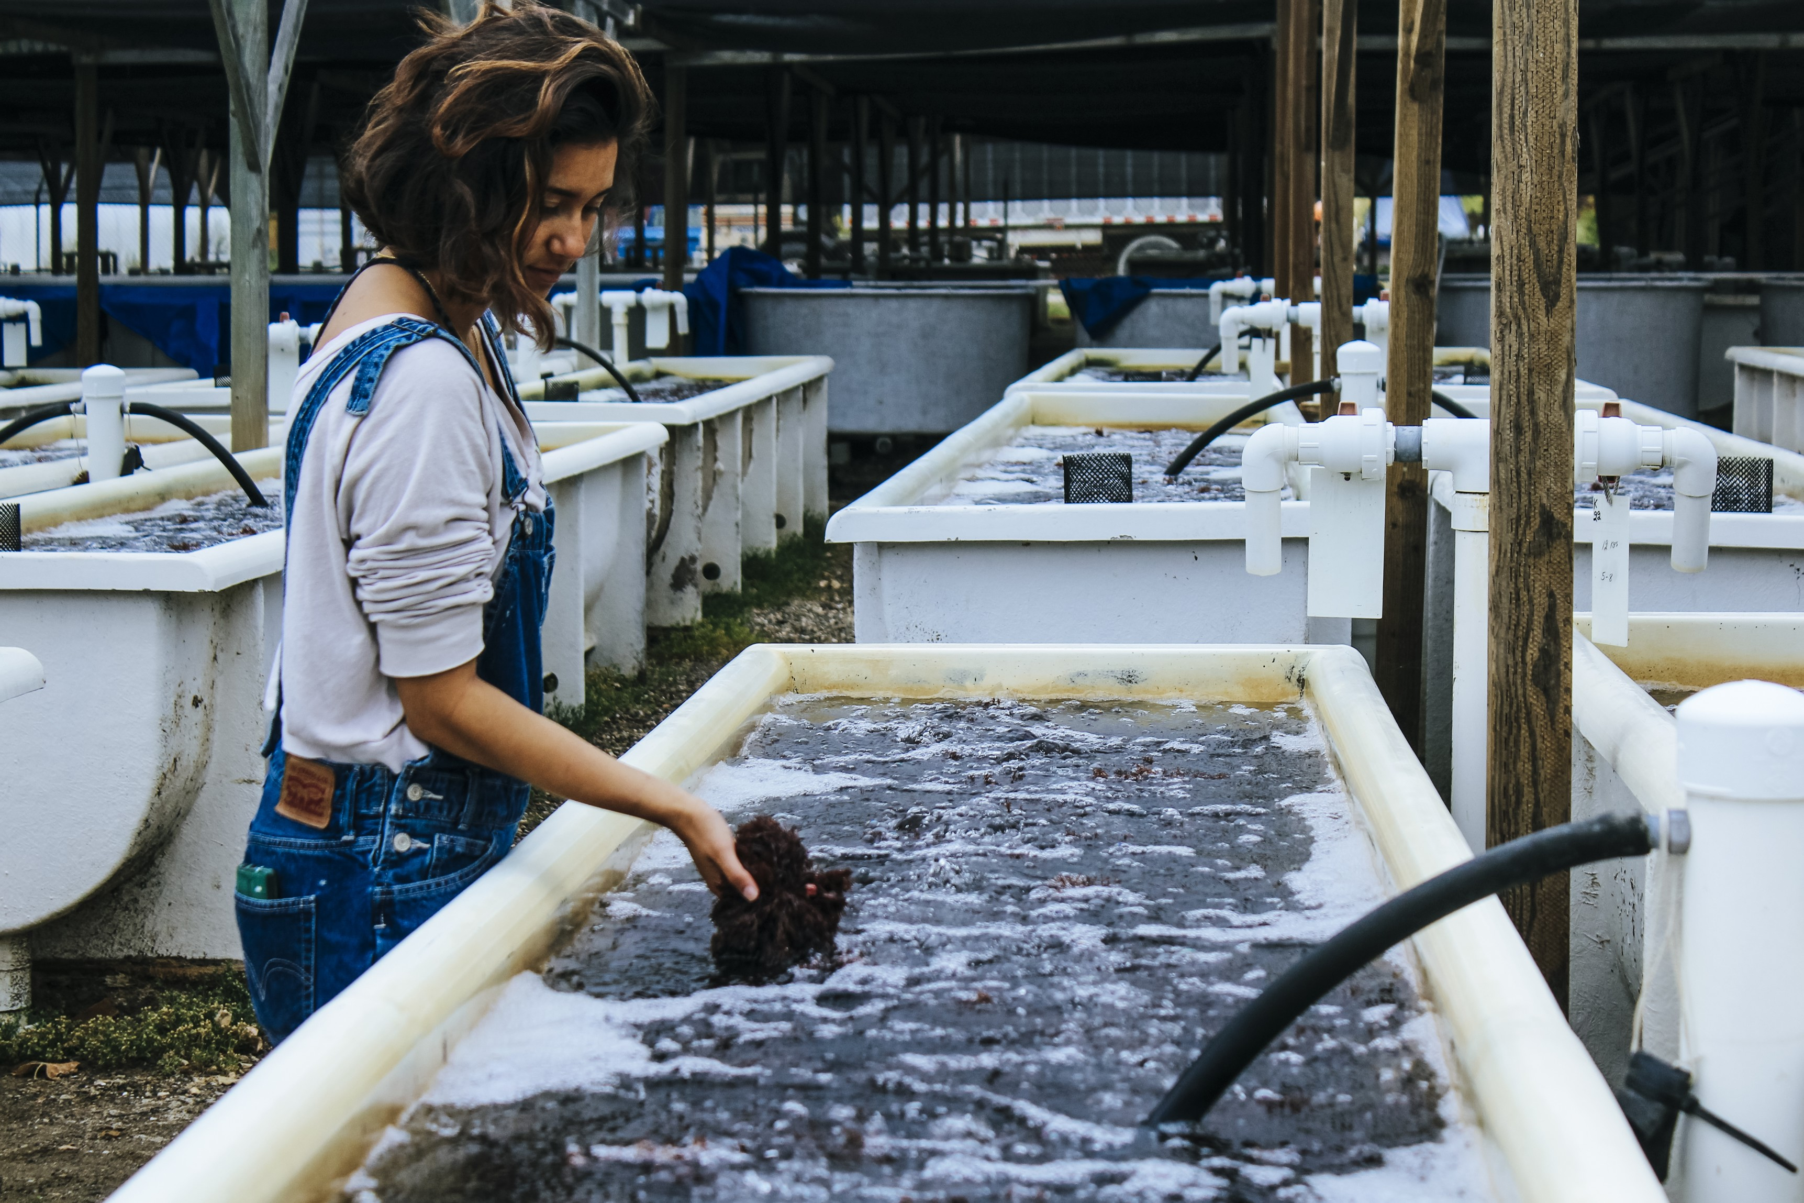
Background: Farm Types
Offshore
Onshore
Notes:
TALKING POINTS:
- As you can see seaweed can also be grown onshore, which allows you to avoid spatial conflicts with ocean users, reduce uncertainty by more carefully controlling the growth requirements, but is typically more energy and labor intensive compared to offshore systems

Slide 7



Background: Bottlenecks
Knowledge Gaps
Seaweed growth and cultivation methods
High Capital Costs
Land, energy, & labour
Permitting
Offshore permitting difficult to obtain
Notes:
SHAUN AND SHELBY:
How to improve this.. I’m sure there is a better way
Something that circles or emphasizes Knowledge gaps
TALKING POINTS:
Despite suitability, there are several bottlenecks that make feasibility less certain
High capital costs
Permitting uncertainty – there aren’t any detailed guidelines for starting a seaweed farm
Insufficient information: many descriptions of cultivation studies/methods are site-specific
GIVE A STORY HERE FOR EACH! BRIEF!!
Our project tackled the last bottleneck, which will help identify what is contributing most to costs and remove informational barriers to help policymakers create a guideline for seaweed aquaculture in CA.

Slide 8
Project objectives
Identify southern CA candidate seaweed species and the appropriate cultivation methods.
Determine key factors that influence economic feasibility in each species-farm system through the use of a bioeconomic model.
Preliminary investigation of incorporating seaweed into an existing mussel farm.
Notes:
TALKING POINTS:
Just read through

Slide 9
Identifying Candidate Algae Species: Methods
Native to the
Southern California
Bight
90 Studies
11 Experts
3 Books
2 Algae databases
Considered species
Commercially grown in aquaculture systems
Currently has a food market
Notes:
SHAUN AND SHELBY:
Original text on left copied below
IS genera found in SB and those native from SB to SD kind of redundant? Also here it says 221 species grown in aquaculture systems, slide 9 only has ~14 ish. So is the explanation there we took the 221 species list and used Tit and Tit to identify the TOP ~14 ish valuable species globally cultivated? SHAUN – I’ll need to talk to you a bit about what slide 10 species are and maybe hear you talk through the whittling
191 genera found in Santa Barbara (Jepson Herbarium 2017)
221 species grown in aquaculture systems (Bott and Nayar, 2014)
Native from Santa Barbara to San Diego
Currently has a food market in California
Total literature for final 4 species: 55 studies, 2 books, 1 experiment, 4 experts
Total on other species: 35 studies, 7 experts, 2 algae databses, 1 book
Additional 110 studies considered, but not used

Slide 10
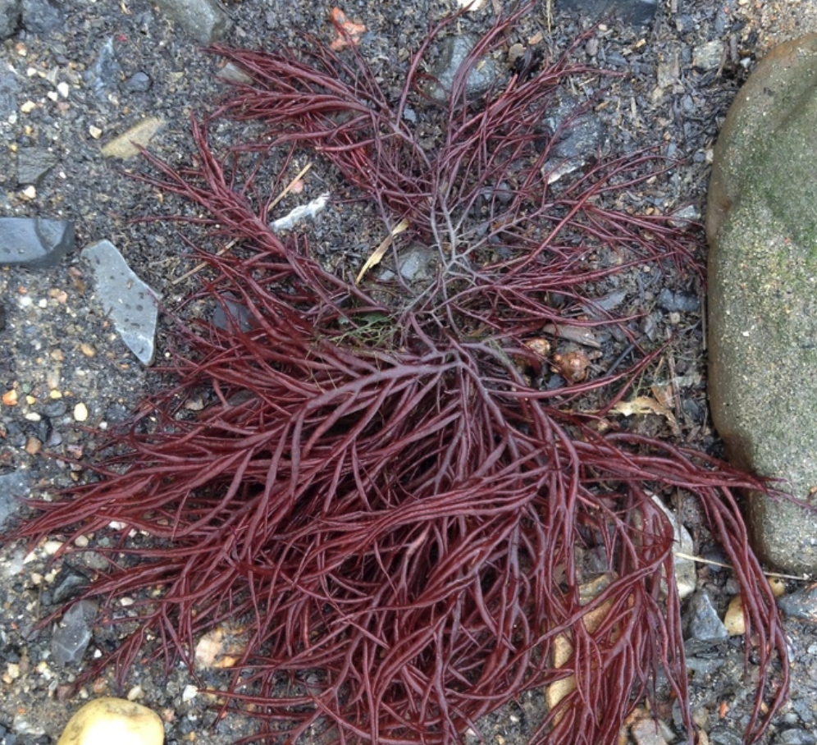
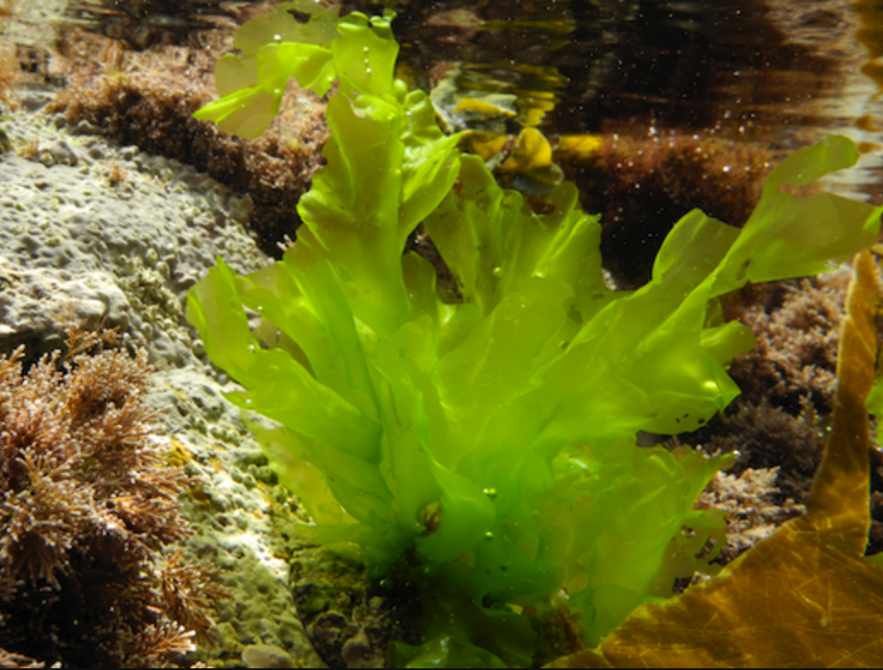
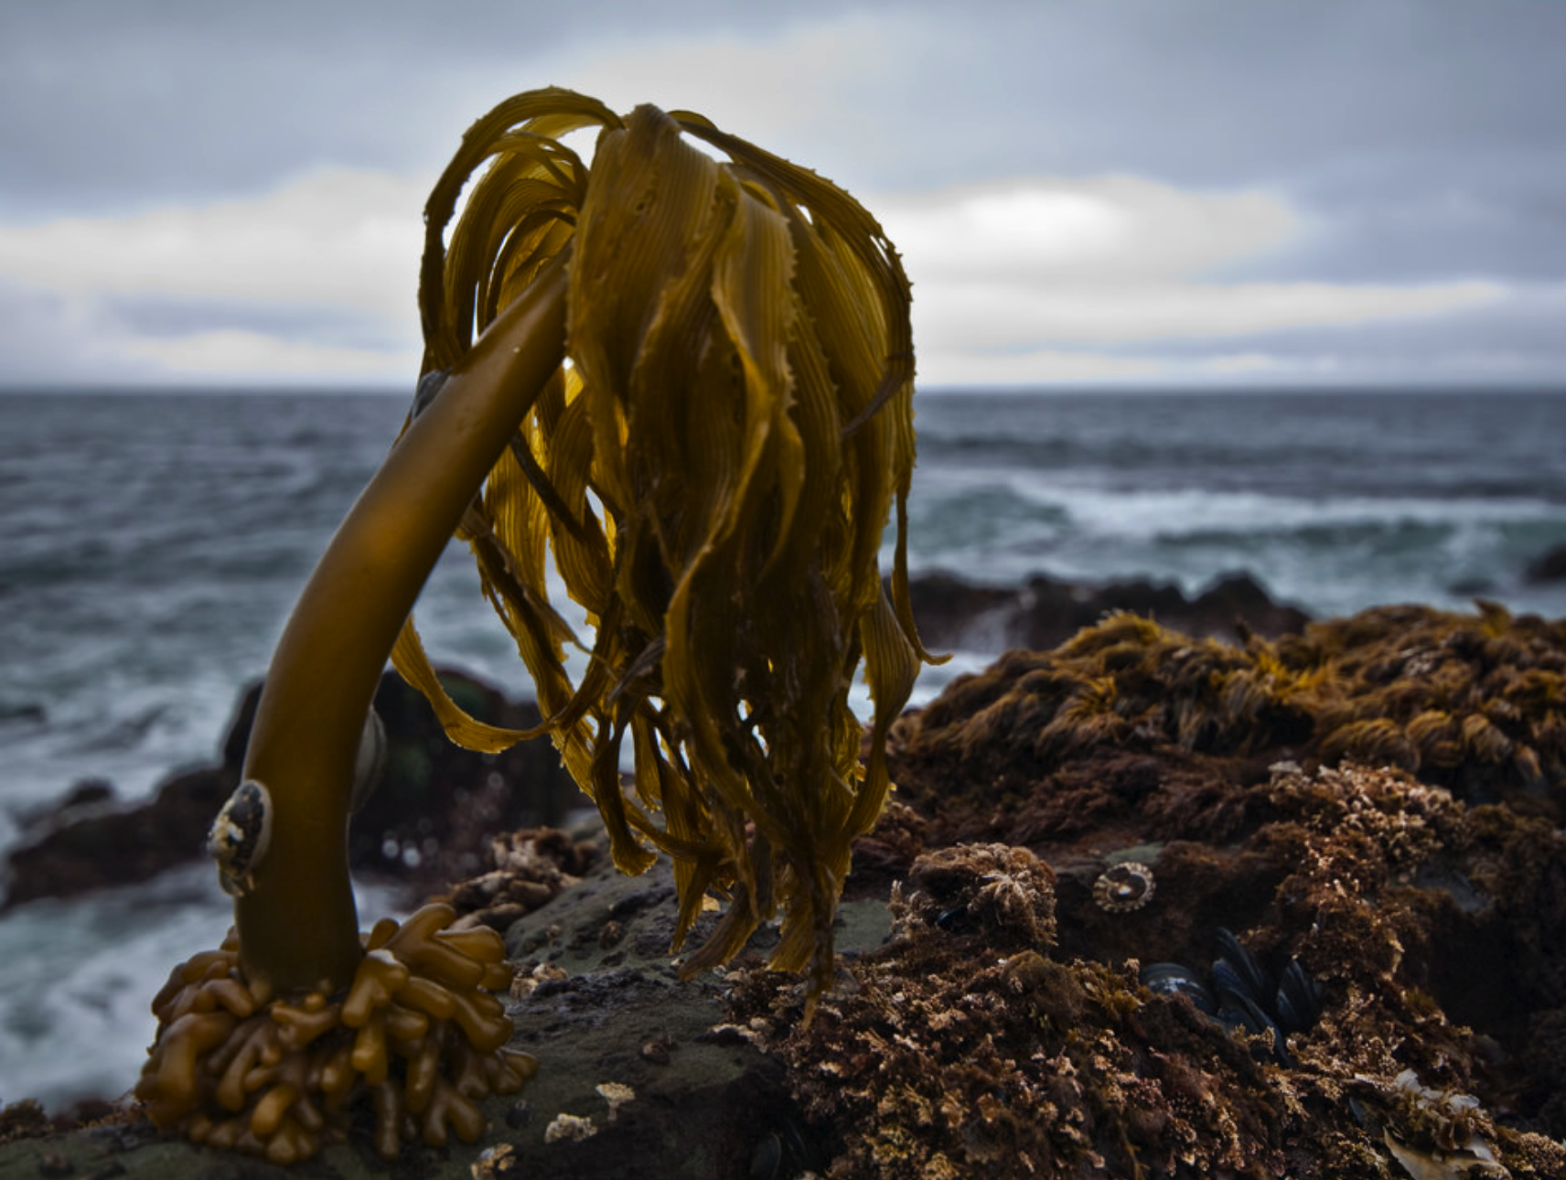
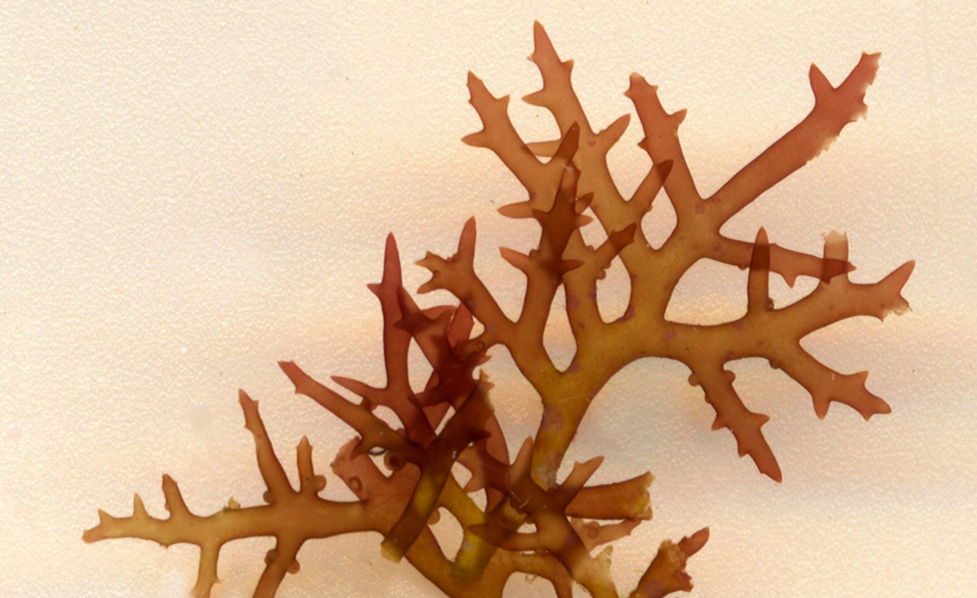
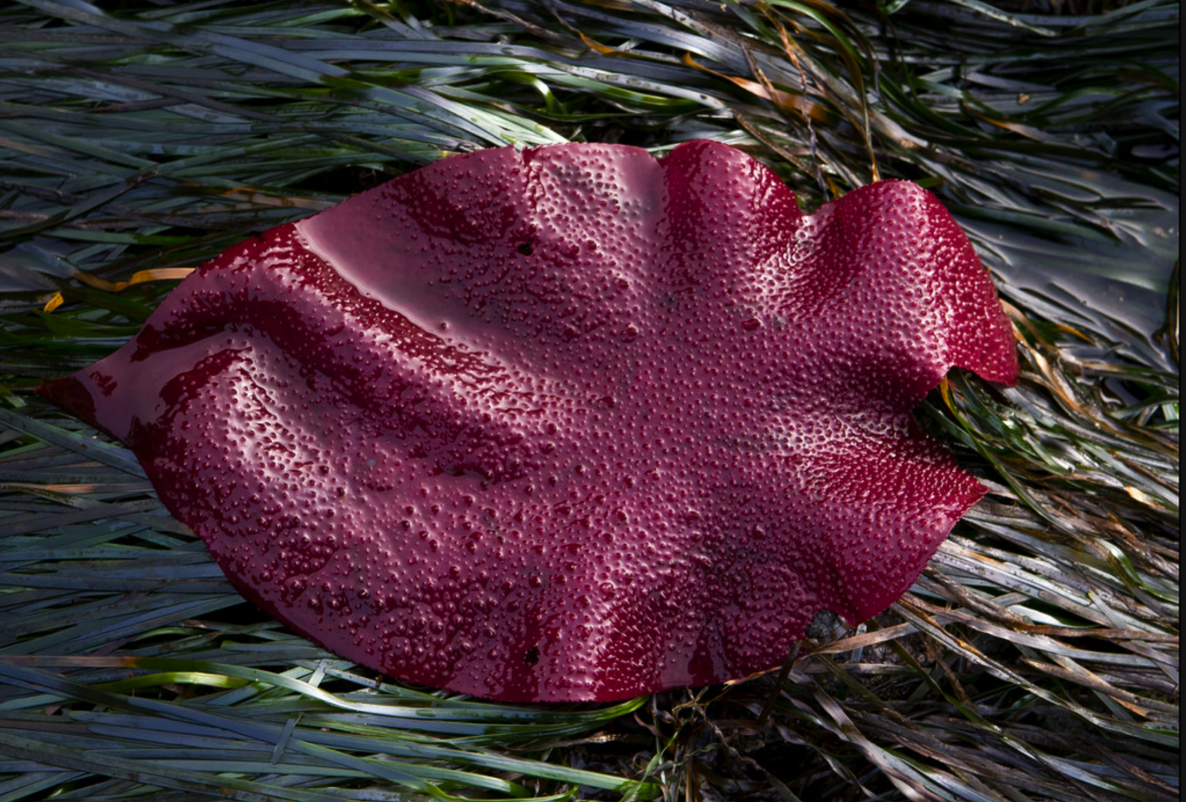
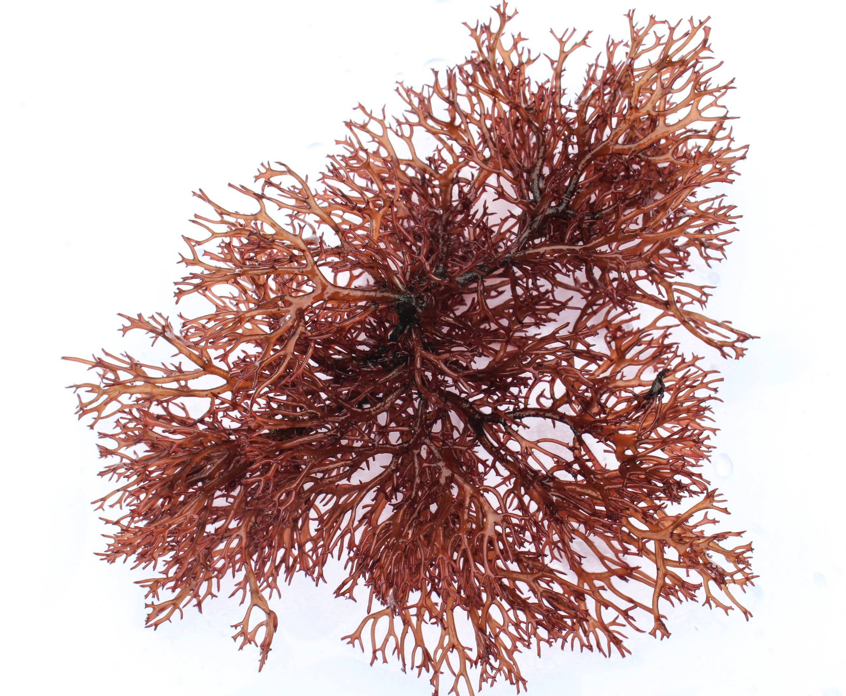
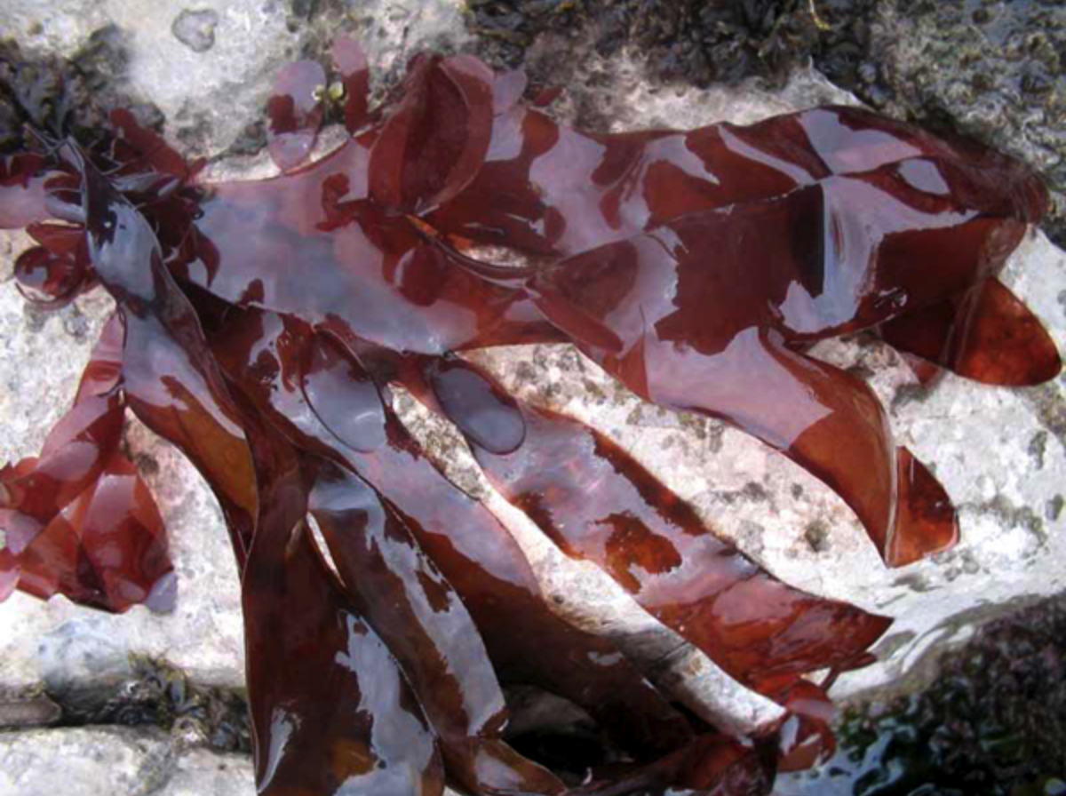
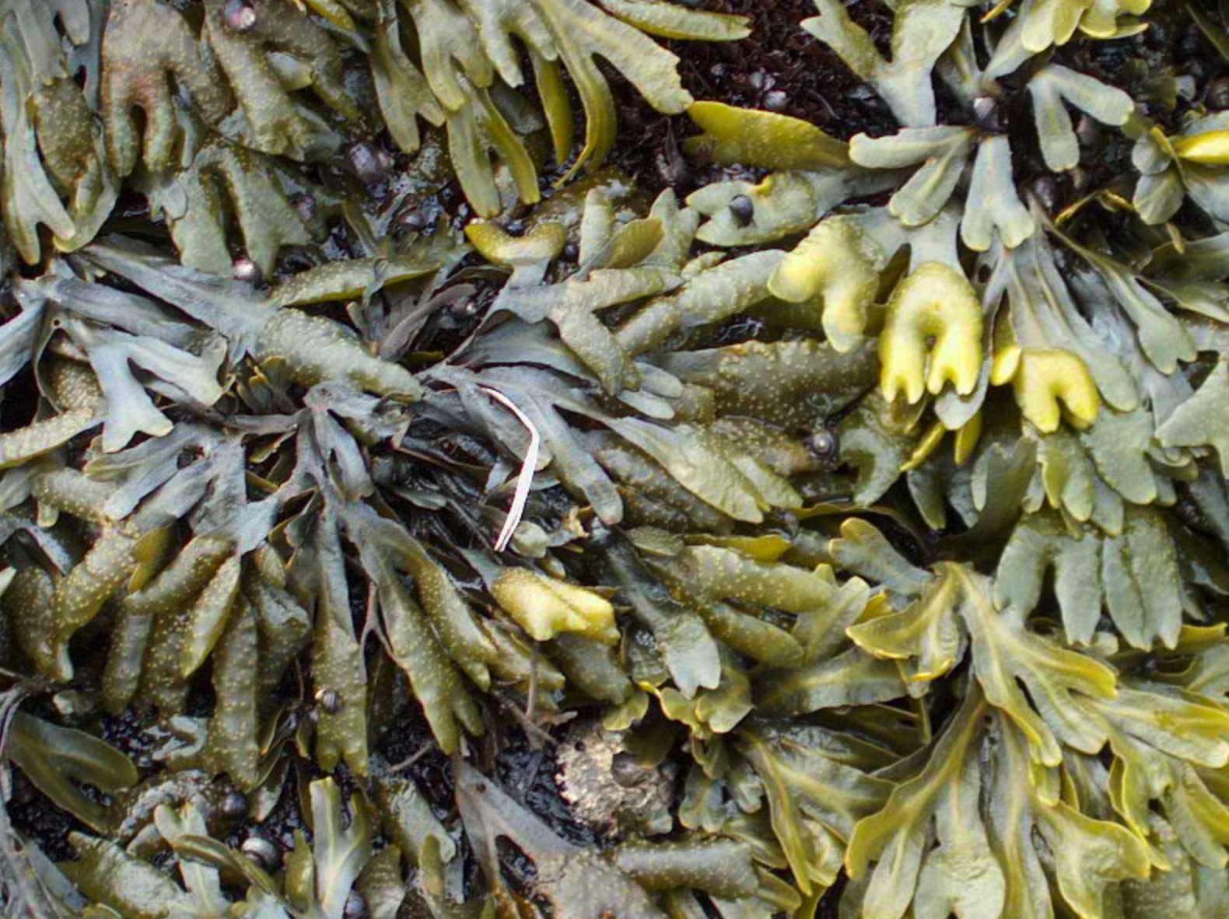
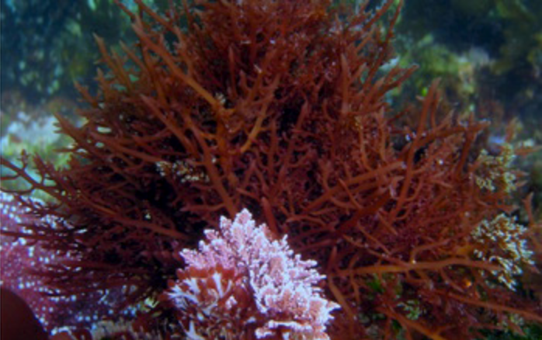
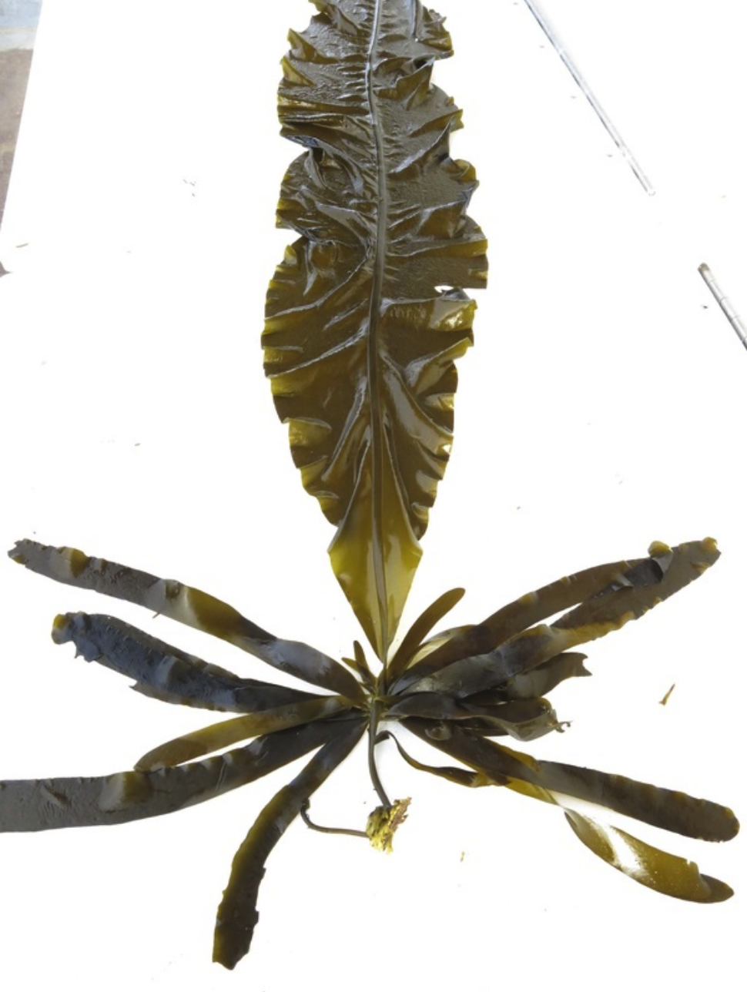
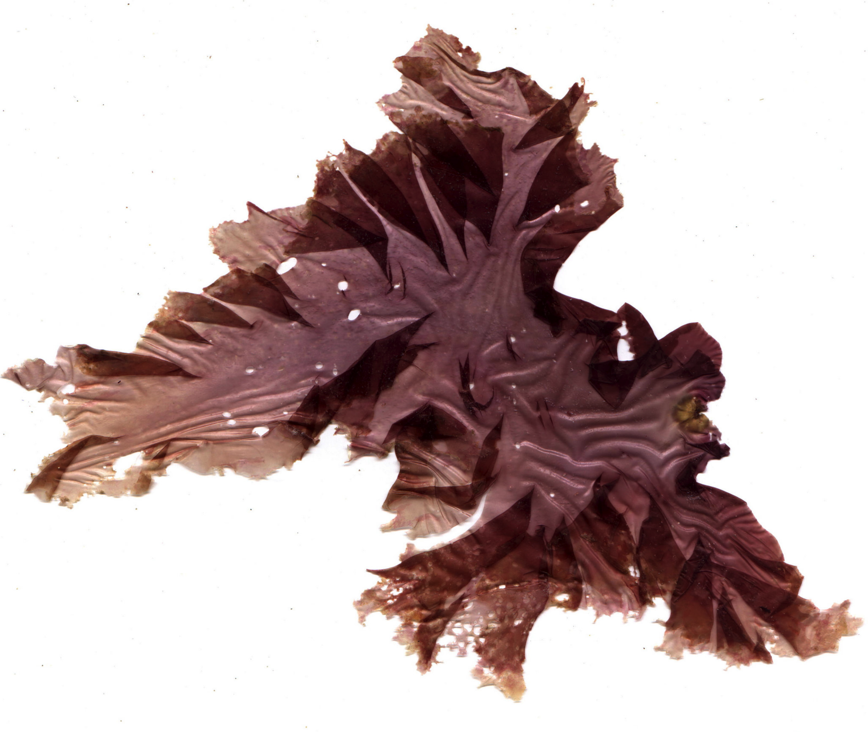
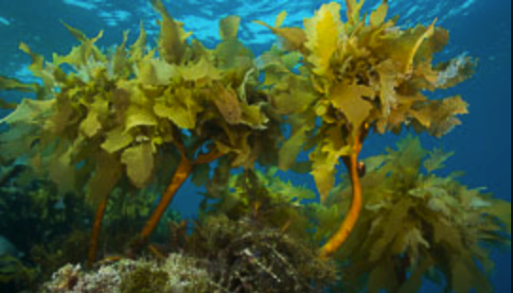
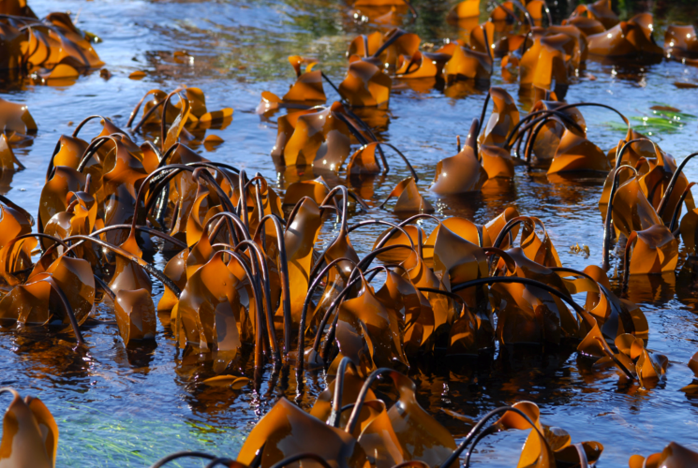
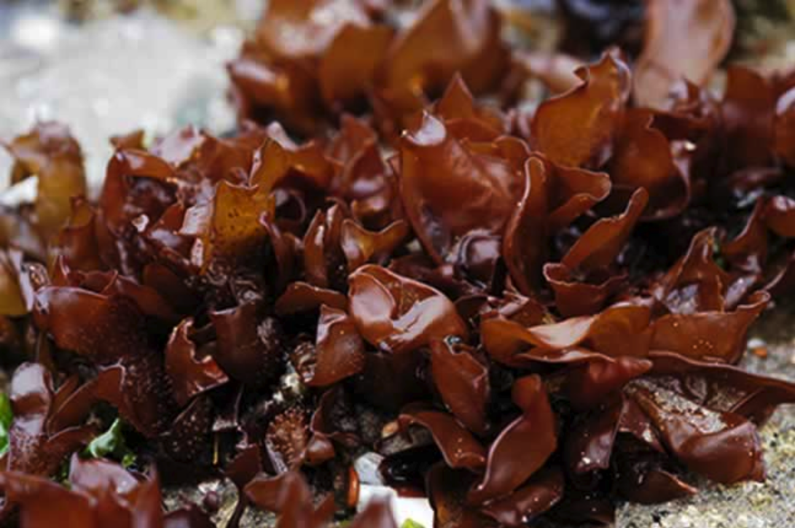
Identify Species: Commercially Grown
Ulva lactuca
(Titlyanov and Titlyanova 2010)
Postelsia palmaeformus (Blanchette and Neilson, 2009)
Hypnea
(Chen, 2013)
Agardhiella coulteri
(Acosta-Salmon et al., 2009)
Chondracanthus exasperatus (Waaland, 2004)
Gracilaria pacifica
(Kim et al., 2017)
Palmaria mollis
(Abbott and Hollenberg, 1992)
Fucus gardneri
(CA DFW, 2018)
Gelidium robustum
(Cremades, 2012)
Alaria marginata
(Flahive et al. 2013)
Eisenia arborea
(Guzman-Calderon et al., 2016)
Laminaria setchellii
(Abbott and Hollenberg, 1992)
Gigartina papillata
(Dawson and Foster, 1982)
Pyropia perforata
(Kim et al., 2017)
Notes:
SHAUN AND SHELBY:
- Better title? Explains what’s going on here? See next slides for ex
Alaria marginata
Gracilaria pacifica
Laminaria sechelli
Chondracanthus exasperatus - FOOD
Postelsia palmaeformus - RANGE
Eisenia arborea - FOOD
Palmaria mollis - RANGE
Gigartina papillata - RANGE
Fucus gardneri - RANGE
Hypnea – FOOD
Ulva lactuca
Pyropia perforata
Gelidium robustum - FOOD
Agardhiella coulteri - FOOD

Slide 11
Identify Species: Southern California Bight
Ulva lactuca
(Titlyanov and Titlyanova 2010)
Postelsia palmaeformus (Blanchette and Neilson, 2009)
Hypnea
(Chen, 2013)
Agardhiella coulteri
(Acosta-Salmon et al., 2009)
Chondracanthus exasperatus (Waaland, 2004)
Gracilaria pacifica
(Kim et al., 2017)
Palmaria mollis
(Abbott and Hollenberg, 1992)
Fucus gardneri
(CA DFW, 2018)
Gelidium robustum
(Cremades, 2012)
Alaria marginata
(Flahive et al. 2013)
Eisenia arborea
(Guzman-Calderon et al., 2016)
Laminaria setchellii
(Abbott and Hollenberg, 1992)
Gigartina papillata
(Dawson and Foster, 1982)
Pyropia perforata
(Kim et al., 2017)
Notes:
FIRST CUT: RANGE – NEEDS TO GROW SB TO SD
Alaria marginata
Gracilaria pacifica
Laminaria sechelli
Chondracanthus exasperatus - FOOD
Postelsia palmaeformus - RANGE
Eisenia arborea - FOOD
Palmaria mollis - RANGE
Gigartina papillata - RANGE
Fucus gardneri - RANGE
Hypnea – FOOD
Ulva lactuca
Pyropia perforata
Gelidium robustum - FOOD
Agardhiella coulteri - FOOD

Slide 12
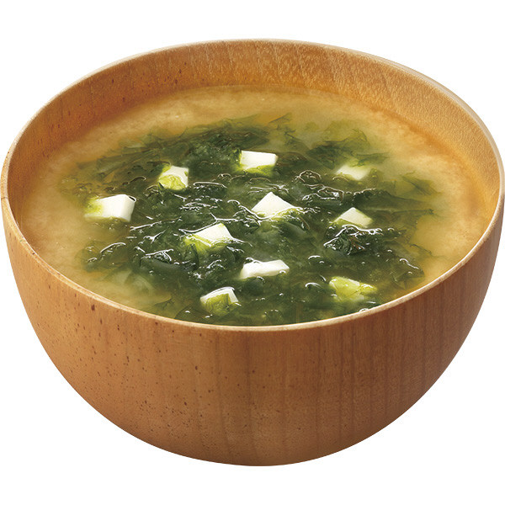
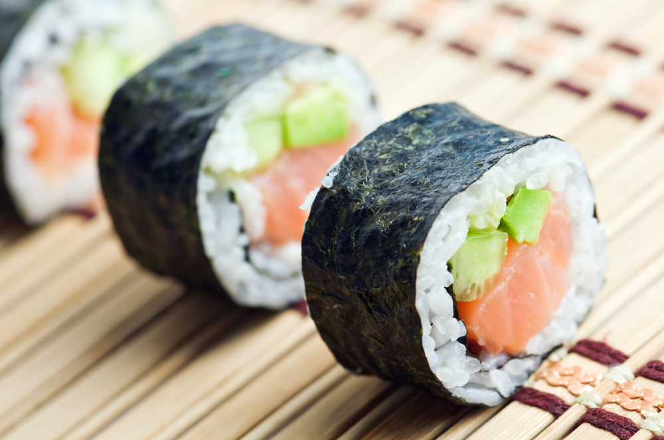
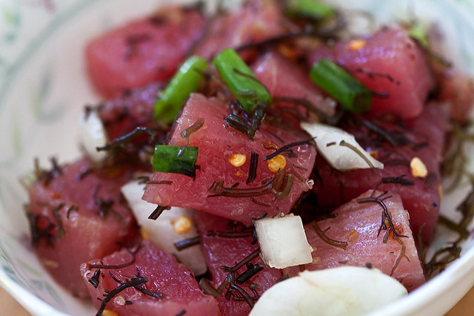
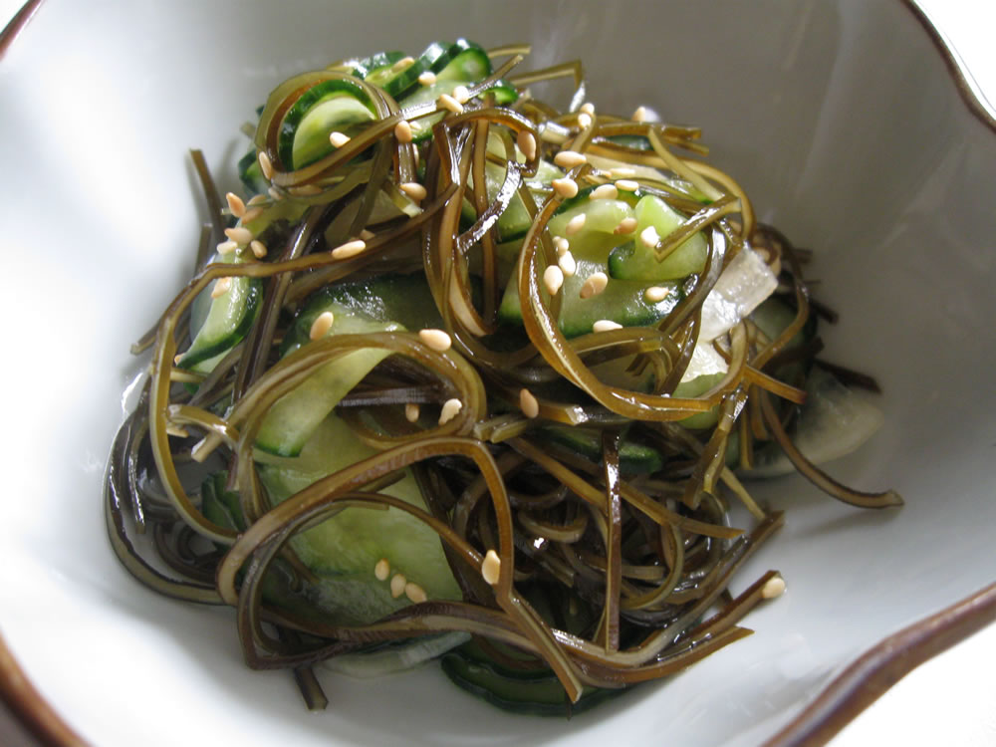
Identify Species: Food Market
SEA
LETTUCE
NORI
Ulva lactuca
(Titlyanov and Titlyanova 2010)
Postelsia palmaeformus (Blanchette and Neilson, 2009)
Hypnea
(Chen, 2013)
Agardhiella coulteri
(Acosta-Salmon et al., 2009)
Chondracanthus exasperatus (Waaland, 2004)
Gracilaria pacifica
(Kim et al., 2017)
Palmaria mollis
(Abbott and Hollenberg, 1992)
Fucus gardneri
(CA DFW, 2018)
Gelidium robustum
(Cremades, 2012)
OGO
KOMBU
Alaria marginata
(Flahive et al. 2013)
Eisenia arborea
(Guzman-Calderon et al., 2016)
Laminaria setchellii
(Abbott and Hollenberg, 1992)
Gigartina papillata
(Dawson and Foster, 1982)
Pyropia perforata
(Kim et al., 2017)
Notes:
SHAUN AND SHELBY:
On point bolded below, any way to improve visuals are all good just improve talking points
Change ‘superlatives???’ or ok
TALKING POINTS:
Give life to these seaweeds!!!!!!
Make people want to eat them!!!!!!!
HUNTER SUGGESTED WE COULD ALSO MENTION STUFF ABOUT ENV. FOOTPRINT HERE.
A lot of nori is imported as well as luminaria, but we have similar species here
Total literature for final 4 species: 55 studies, 2 books, 1 experiment, 4 experts
Total on other species: 35 studies, 7 experts, 2 algae databses, 1 book
Additional 110 studies considered, but not used
Per weight, Pyropia has the highest protein content
Gracilaria – 7-13% protein
Laminaria – 8-15%
Ulva – 13.6% protein
Pyropia – 36-47% protein

Slide 13
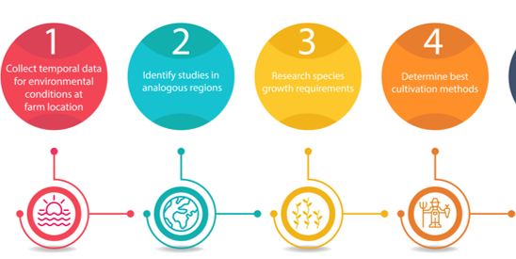
Identify Growth & Cultivation Methods
200+ studies considered, 11 experts consulted
Peteiro et al 2016, Titlyanov& Titlyanova 2010, Gentry et al 2017
Notes:
½ MINUTE
Polish these objectives?

Slide 14
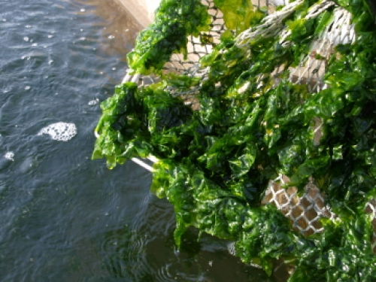
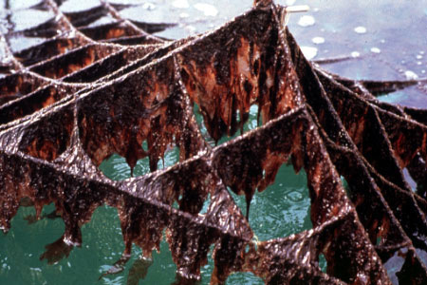
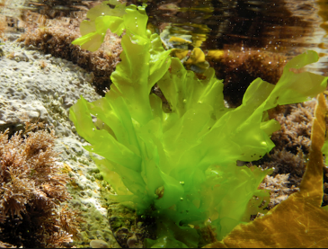

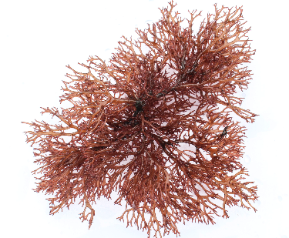
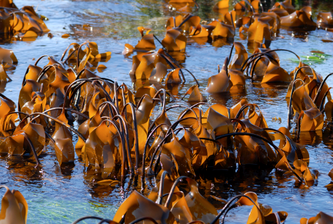
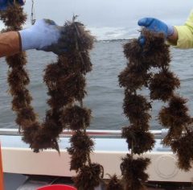
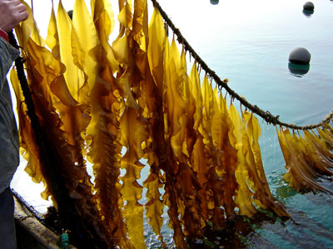
Candidate Species: Summary
Net Cultivation
SEA LETTUCE
NORI
OGO
KOMBU
Longline Cultivation
Notes:
SHAUN AND SHELBY:
Ugly
TALKING POINTS:
- Better explain transition from bubble 4 to bubble 6

Slide 15

Project objectives
Identify southern CA candidate seaweed species and the appropriate cultivation methods
Determine key factors that influence economic feasibility in each species-farm system through the use of a bioeconomic model.
Preliminary investigation of incorporating seaweed into an existing mussel farm.
Notes:
½ MINUTE
Polish these objectives?

Slide 16
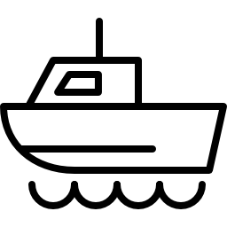






Bioeconomic Model: Concept
Inputs
Outputs
Costs
Start Up Cost
Operating Cost
Annual
Production
Model
Biological Information
Growth Rate
Life Cycle
Limiting Factor
Harvest Schedule
Stocking Density
Market Information
Southern
California: $18/kg
Hawai’i: $7/kg
Global: $3/kg
Economic Feasibility
Net Present Value
Payout Schedule
Notes:
-Model slide:
-Costs: start-up and operating costs
-market information: 3 major markets (on top) and then quant/price bullet
-biological production -> annual production
-Profitability -> Economic Feasibility
-bullet points: Net Present Value, Break Even Price, Payout Schedule

Slide 17




Bioeconomic Model: Assumptions
Offshore farm size: 25 acres (10.4 hectares)
Onshore farm scaled to match production of offshore farm
Lease structure at both locations
Notes:
-visual for assumptions slide (icons or picture)

Slide 18
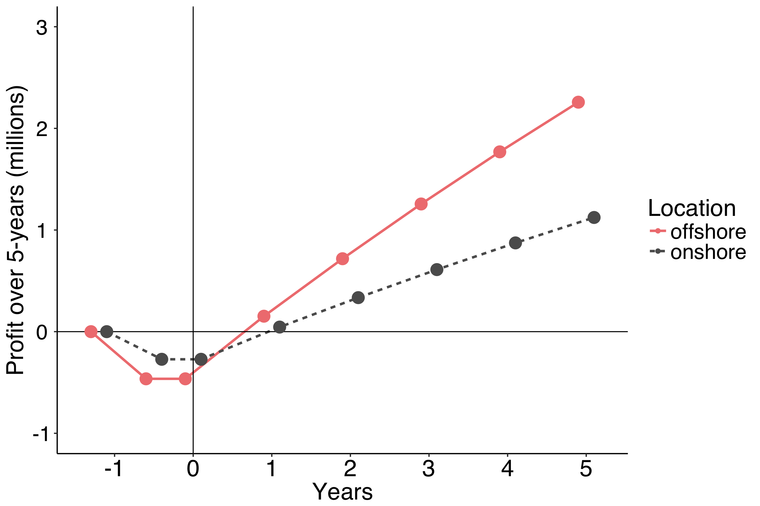
Bioeconomic Model: Ogo Cost Structure (Local)
Notes:
-cash flow -> remove annotation on points and in legend, retain location legend. Ensure that y-axis really is profit (or switch label to NPV)

Slide 19
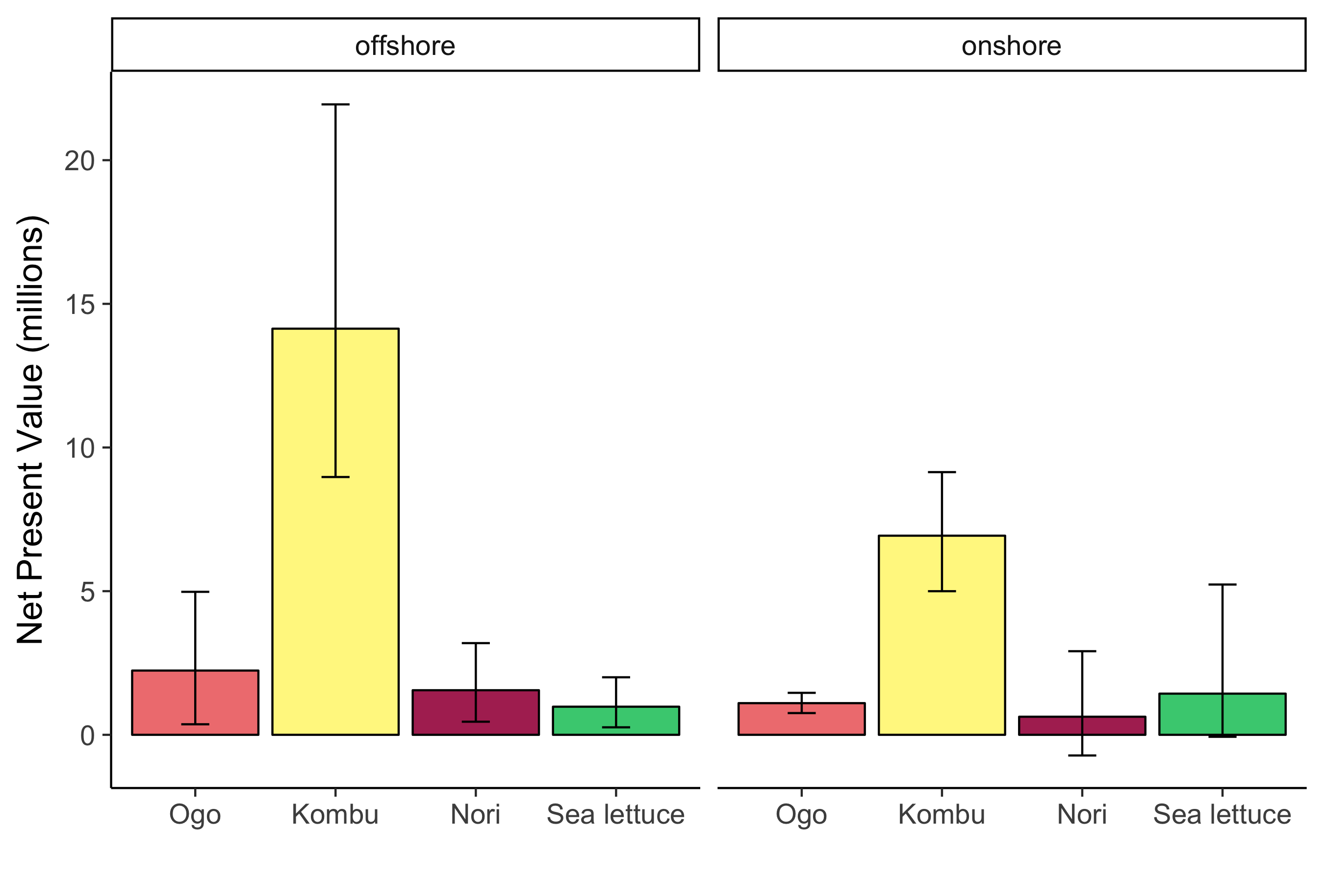
Bioeconomic Model: 5-year Productivity
Notes:
-NPV: change y axis to NPV (USD)
-All graphs: colors, species labels (Genus?), and number tweaking on all y-axes (sci notfation, millions scale)

Slide 20
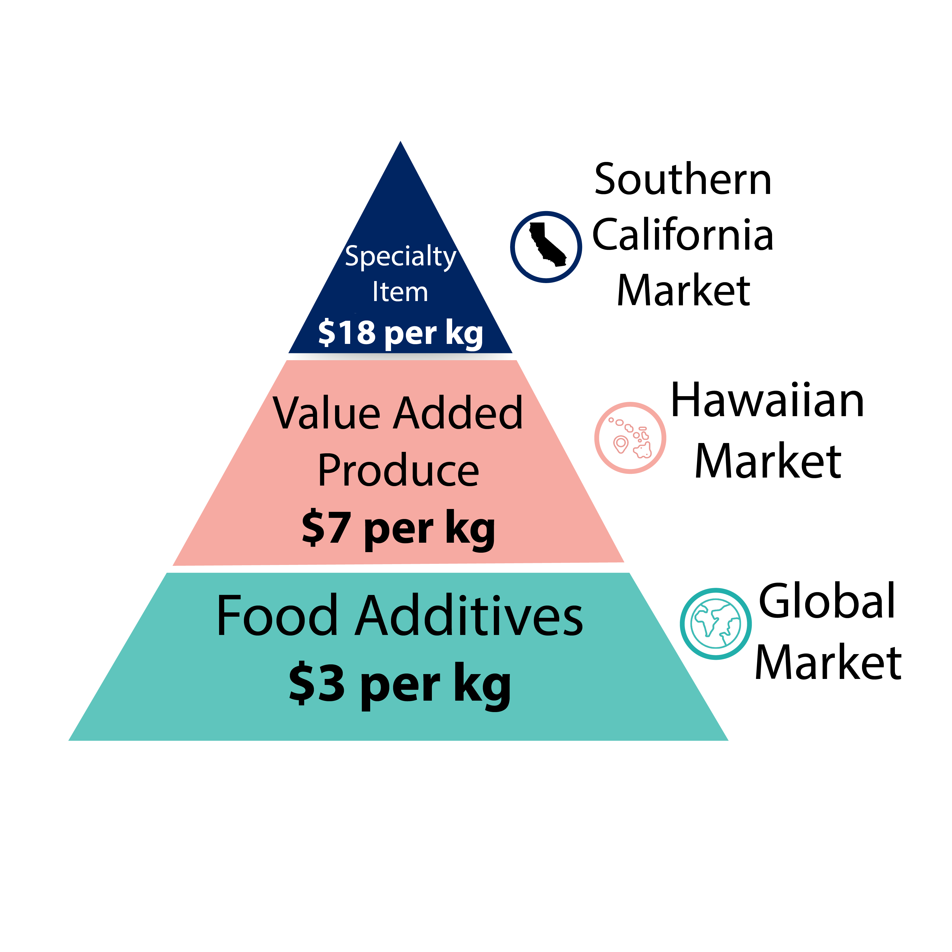
Bioeconomic Model: Markets
Notes:
-pyramid: finish visual, add price points (get Price points?)
-pyramid: need to convey three pieces of info: what is sold, location, price point (how do we confer)
Pyramid: ask Shelby: what do we call these markets (“what is sold”)?

Slide 21
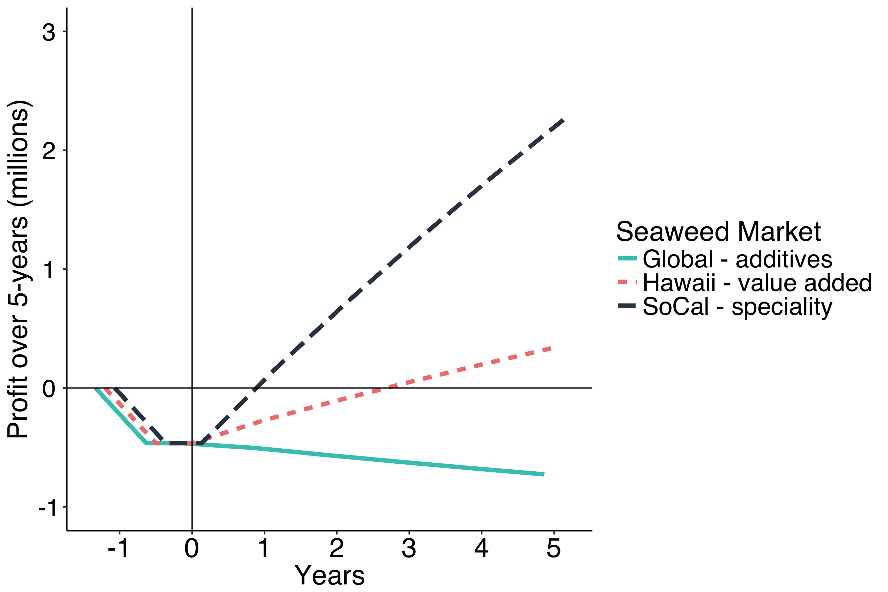
Bioeconomic Model: Ogo Market Scenarios
Notes:
-market scenarios cash flow: replace price legend with locations (SoCal, Hawaii, Global)
-market scenarios cash flow: scale y – axis to make numbers pop! Cap at 2.5-4 million

Slide 22

Bioeconomic Model: Key Factors
Notes:
-summary slide: infographic or icons for three key factors
: environmental conditions and seaweed growth rate
: price point and quantity demanded

Slide 23
Co-culture: Addressing the Barriers
Permitting: Leveraging existing permits
Knowledge Gaps: Similarities in the cultivation methods
High Capital Costs: Cost saving synergies
Notes:
I’d like to return to the triangle of barriers here to discuss the above talking points. We can either bring back that visual or I can just reference it
Don’t love my bullet points as they are, I’ll try to come back to them shortly
ALSO!!!!!!! PERMITTING SHOULD BE THE PAPER ICON, AND THE HEAD IS KNOWLEDGE GAPS

Slide 24
Project objectives
Identify southern CA candidate seaweed species and the appropriate cultivation methods
Determine key factors that influence economic feasibility in each species-farm system through the use of a bioeconomic model.
Preliminary investigation of incorporating seaweed into an existing mussel farm.
Notes:
Have our model system, which is a 25 acre mussel farm currently producing mussels at full capacity. So, if we want to access any of the benefits of co-culture such as economic diversification, we will need to reduce the acreage being used for mussels and replace it with seaweed.
USING OGO

Slide 25
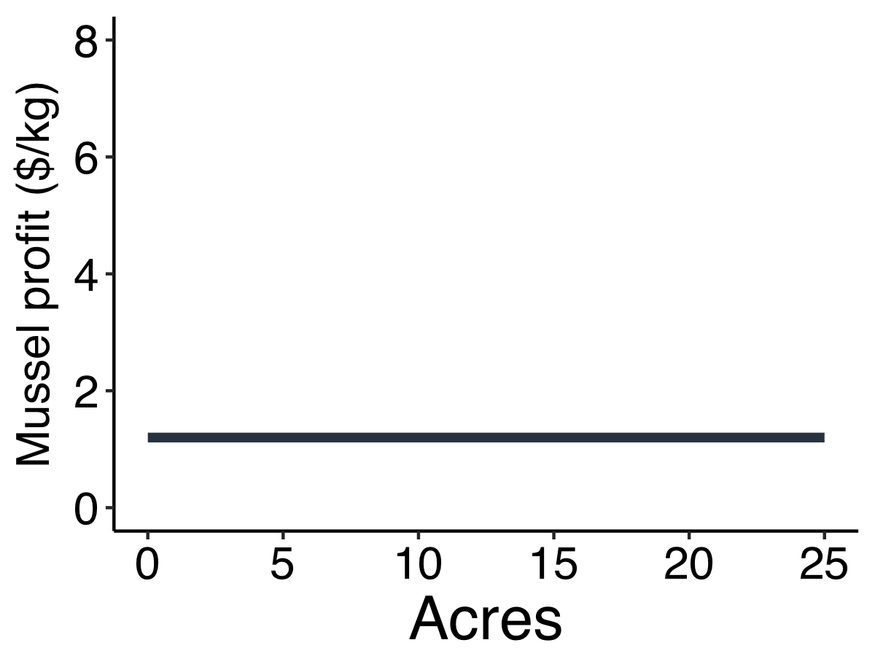
Investigate Co-culture
Notes:
Have our model system, which is a 25 acre mussel farm currently producing mussels at full capacity. So, if we want to access any of the benefits of co-culture such as economic diversification, we will need to reduce the acreage being used for mussels and replace it with seaweed.
USING OGO

Slide 26
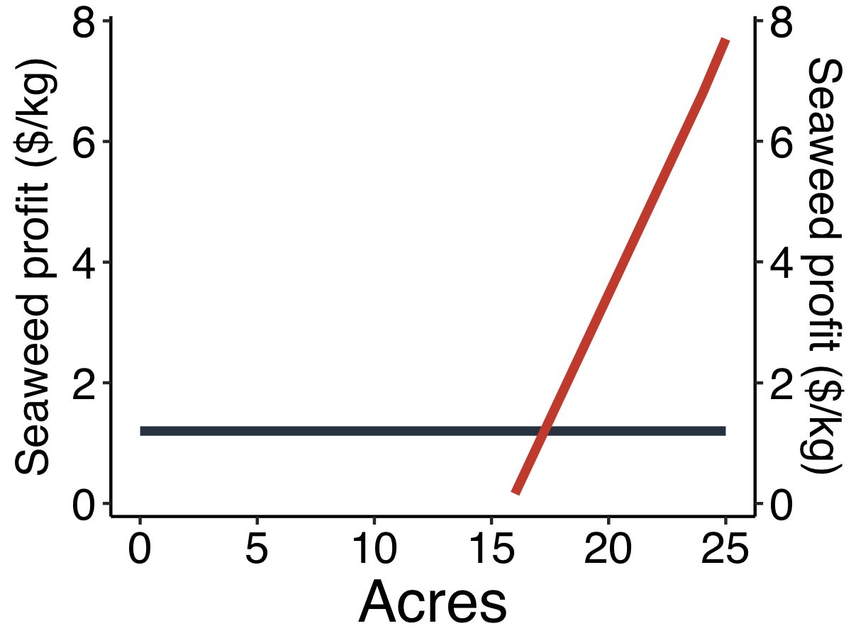
Investigate Co-culture
25 20 15 10 5 0
Notes:
Have our model system, which is a 25 acre mussel farm currently producing mussels at full capacity. So, if we want to access any of the benefits of co-culture such as economic diversification, we will need to reduce the acreage being used for mussels and replace it with seaweed.
USING OGO

Slide 27
Investigate Co-culture
25 20 15 10 5 0
Notes:
Have our model system, which is a 25 acre mussel farm currently producing mussels at full capacity. So, if we want to access any of the benefits of co-culture such as economic diversification, we will need to reduce the acreage being used for mussels and replace it with seaweed.
USING OGO

Slide 28



Investigate Co-Culture: Societal Benefits
Buffering localized change to ocean conditions
Combating eutrophication (terrestrial systems)
Switching to local products
Notes:
Mussel to Seaweed ratio 7:18 acres
Increase profits by

Slide 29
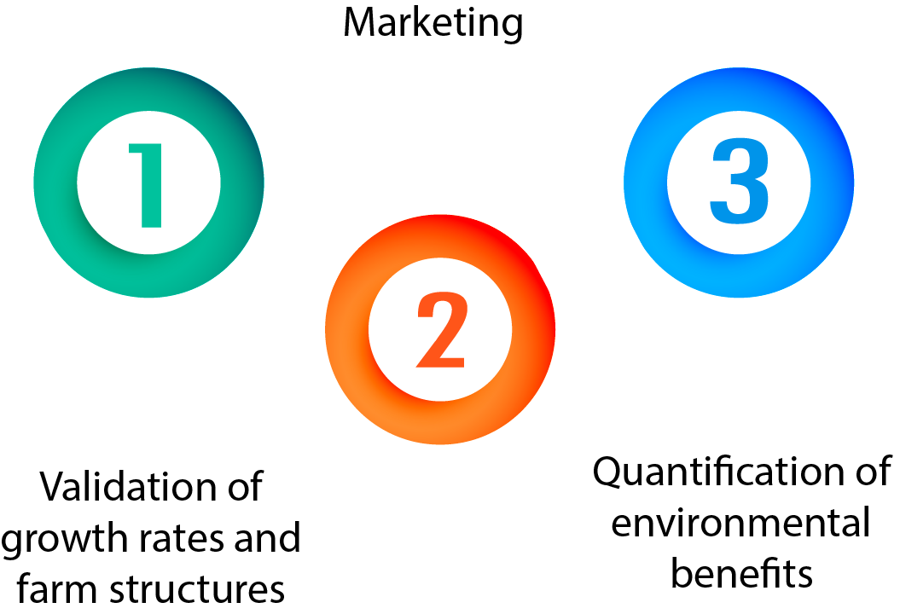
Future Steps
Notes:
Switching quant of env benefits and marketing

Slide 30
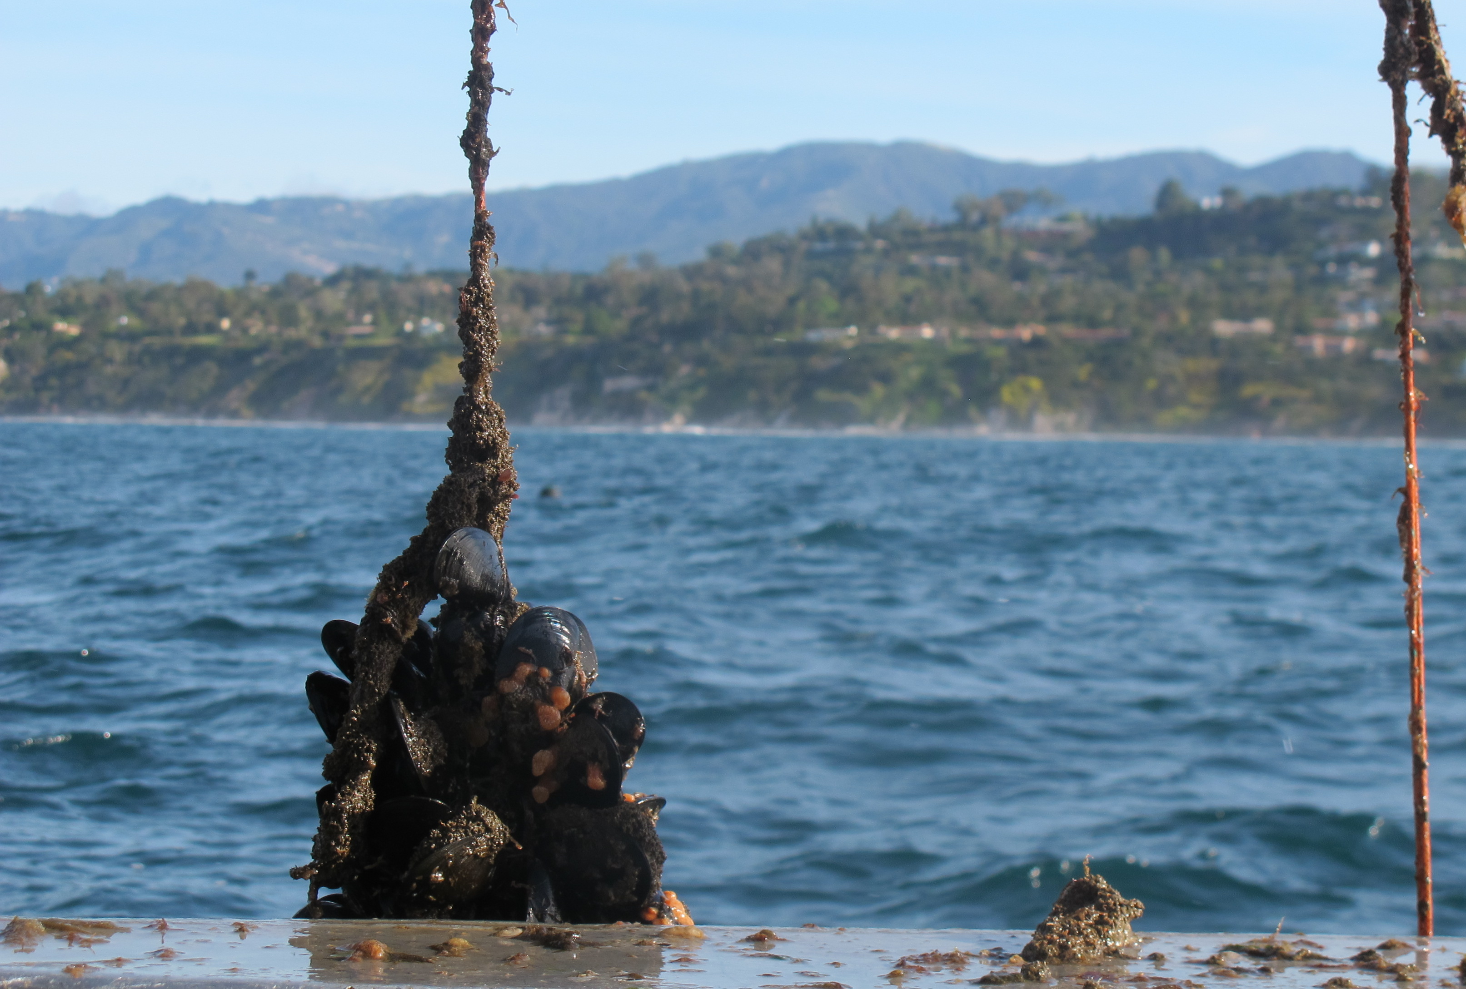
Conclusions
Seaweed has many environmental and health benefits when sited locally
Identified candidate species and their appropriate cultivation methods that should be considered when scoping the future of California seaweed aquaculture
These systems can be economically feasible with a transition in the seaweed market
Integration with shellfish aquaculture can build momentum in the short term
Notes:
-lol actually do acknowledgement slides
clients
faculty advisors
phd (JESSICA <3)
external advisors
interns
expert consultation

Slide 31
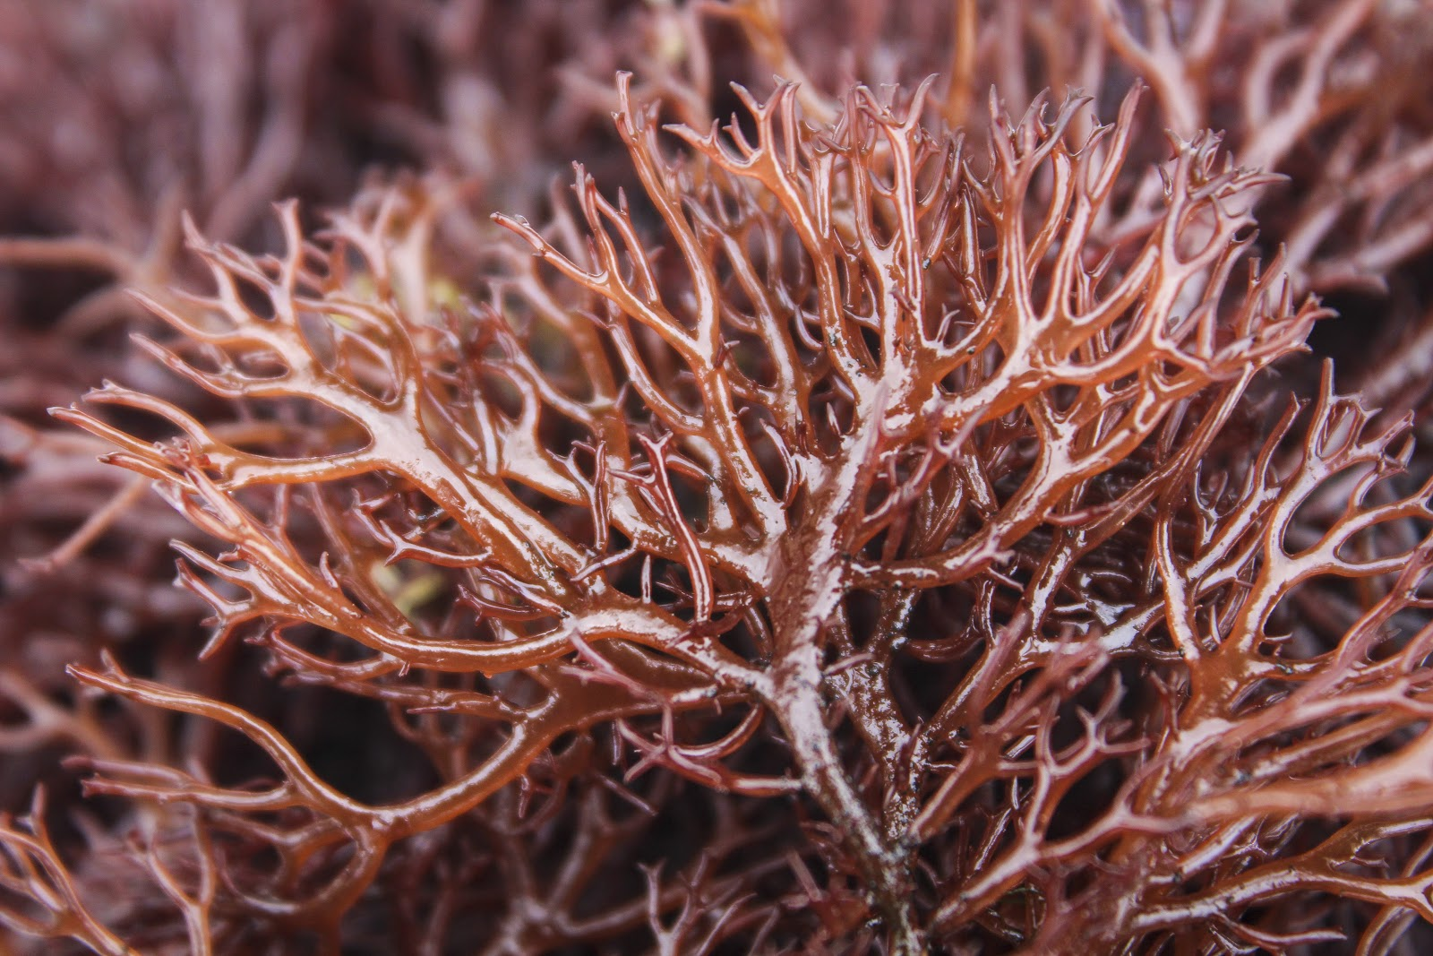
Acknowledgements
A special thank you to:
Hunter Lenihan, Advisor
Bernard Friedman, Client, Santa Barbara Mariculture
The Sustainable Aquaculture Research Center (SARC), Client
Jessica Couture, PhD Advisor
Phoebe Racine, SARC
Doug Bush, External Advisor, The Cultured Abalone Farm
Norah Eddy, External Advisor, Salty Girl Seafood
We’d also like to thank the following experts:
Dan Marquez, Dr. Michael Friedlander, Dr. John Corbin, Dan Reed, Peter Fischer, Randy Lovell, J. Robert Waaland
Additional thank you to: Sutara, SARC, Intern
Notes:
-lol actually do acknowledgement slides
clients
faculty advisors
phd (JESSICA <3)
external advisors
interns
expert consultation

Slide 32
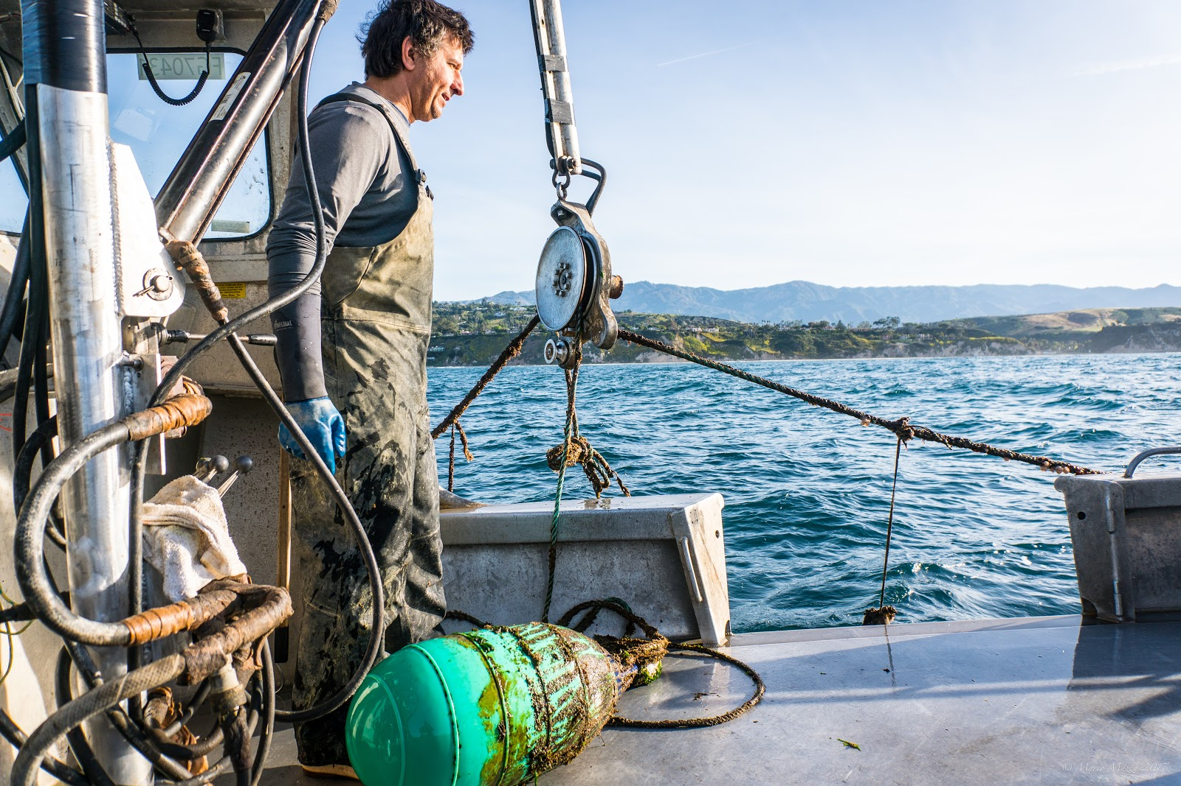
THANK YOU
Notes:
Maybe a photo

Slide 33
Back-up Slides
Notes:
-break-even better to go up and down or sideways?

Slide 34
Bioeconomic Model: Break Even Prices
Notes:
-break-even better to go up and down or sideways?

Slide 35
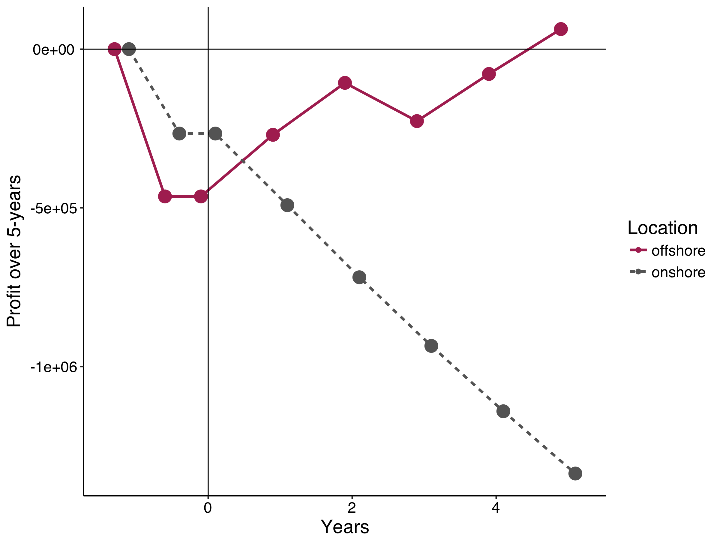

Slide 36
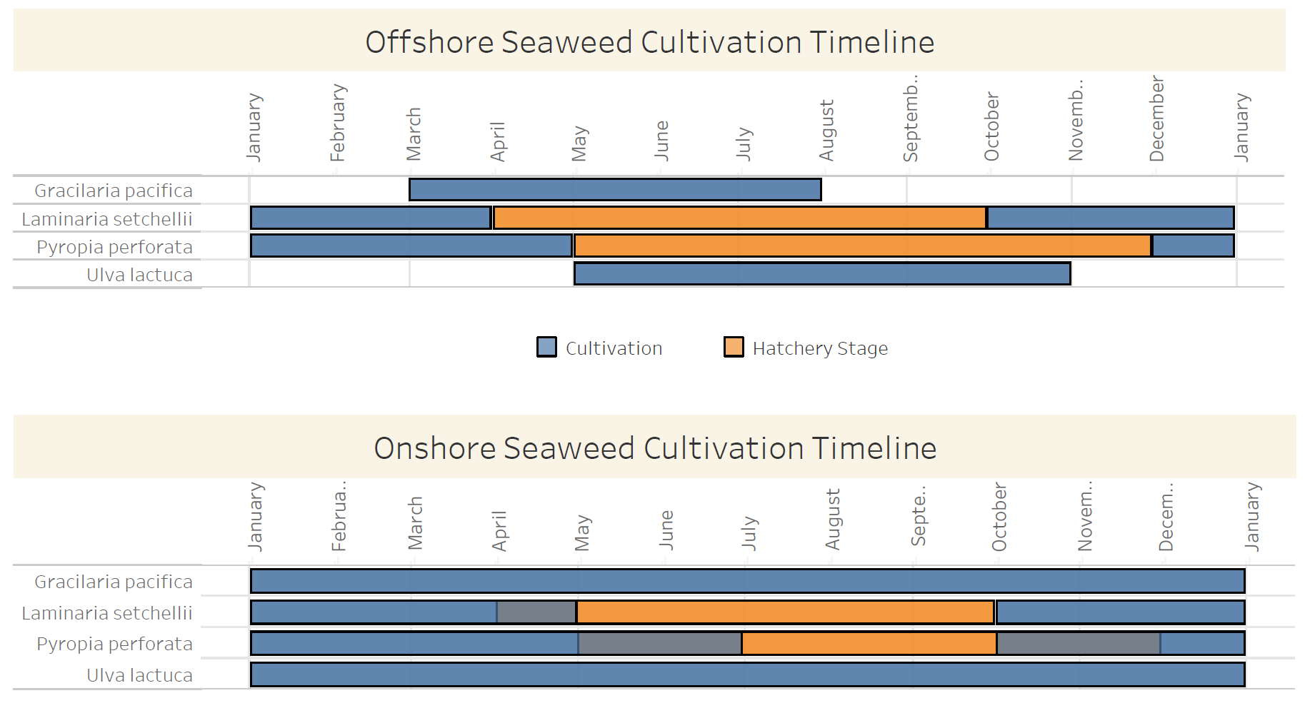
Cultivation & Hatchery Timeline
Notes:
Show harvest frequency on here?? How without cluttering??

Slide 37
Growth & Cultivation Parameters (11)
Dominant reproductive method: vegetative or reproductive
Common farm cultivation type (that is feasible): longline, net, tank
Smallest unit of farm type
Initial stocking density
Expected high growth rate
Expected low growth rate
Common duration of cultivation period
Common duration of hatchery grow out
Harvest frequency
Reproductive period
Natural peak occurrence
Notes:
Show harvest frequency on here?? How without cluttering??

Slide 38
Growth & Cultivation Data Sources
Notes:
Show harvest frequency on here?? How without cluttering??

Slide 39
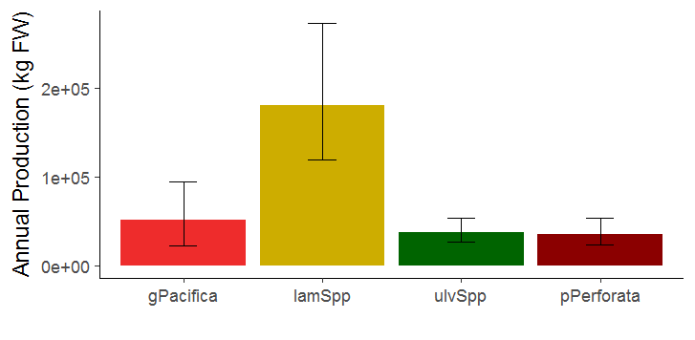
Back-Up Slides

Slide 40
Back-Up Slides
Table or something of growth rates or final yield, harvest frequency
Initial parameters from papers (11)
Dominant reproductive method: vegetative or reproductive
Common farm cultivation type (that is feasible): longline, net, tank (logistical farm factor)
Smallest unit of farm type (logistical farm factor)
Initial stocking density
High growth rate (likely in soCA)
Low growth rate (likey in soCA)
Common duration of cultivation period (logistical farm factor)
Common duration of hatchery grow out (logistical farm factor)
Harvest frequency (logistical farm factor)
Reproductive period
Natural peak occurrence

Slide 41
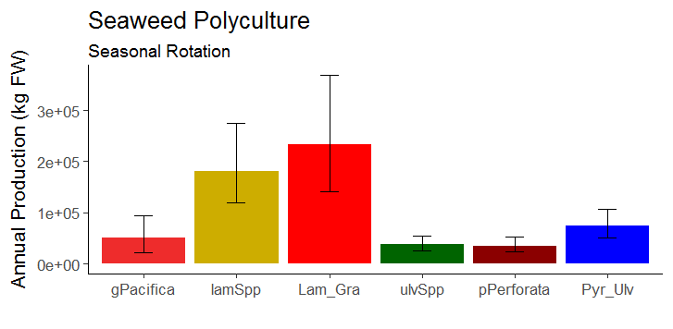
Back-Up Slides

Slide 42
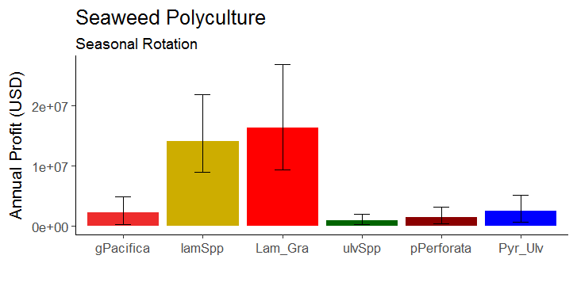
Back-Up Slides

Slide 43
Methods
Current profit ($/kg) of mussels
Estimate current seaweed market in CA
Quantity and price ($/kg) aggregated across farm and wild harvest
Cost ($/kg) for seaweed
Notes:
To address this objective, there were three main pieces of information we had to gather. First for mussels, it was what is the current profit of mussels ($/kg). Then, for seaweed, what are the costs associated with producing a kilogram of seaweed, and second, how does increasing the quantity of seaweed sold on the market affect the price ($/kg) you receive? Addressing this involved estimating current demand of seaweed, which was done by aggregating the quantity and price received for the product across aquaculture and wild-harvesters in CA.

Slide 44
Current Demand for Seaweed
~8022 kg produced annually in CA, at $19/kg
Notes:
To determine the point at which the seaweed profit curve intersects with the mussel profit curve, we had to estimate the demand curve for current high end restaurant grade seaweed in CA.
This gave us a single point, and we back-calculated the demand curve using a elasticity value obtained from literature for a local high-end produce product, which gave us a slope for the demand curve.

Slide 45
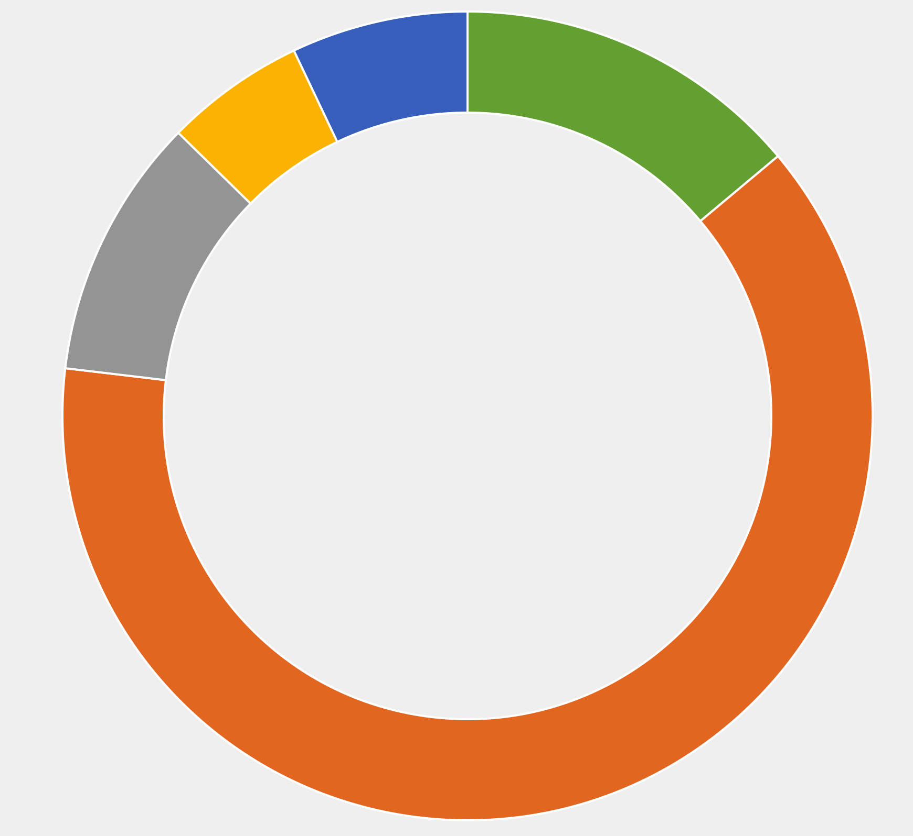

Bioeconomic Model: Cost Breakdown
Offshore
Onshore
Marginal Labor Cost
Labor for harvest
Marginal Labor Cost
Labor for harvest
Operational Marginal
Cost
Stocking cost
Fixed Independent Cost
Initial permitting
EIR
Construction cost
Boat
Fixed Independent
Cost
Initial
permitting
Construction
cost
Annual Costs
Annual permits and fees
Salaried staff
Fixed Dependent
Costs
Materials cost
Operational Marginal
Cost
Stocking cost
Annual lease
Annual Costs
Salaried staff
Fixed Dependent Costs
Materials cost
Notes:
-pie charts: too busy I think. I vote we slash all the sub-bullets and keep the fully annotated one as a backup slide

Slide 46
Notes:
Mussel to Seaweed ratio 7:18 acres
Increase profits by

Slide 47


Slide 48


Slide 49
Identify Species: Local Food Market
Ulva lactuca
(Titlyanov and Titlyanova 2010)
Postelsia palmaeformus (Blanchette and Neilson, 2009)
Hypnea
(Chen, 2013)
Agardhiella coulteri
(Acosta-Salmon et al., 2009)
Chondracanthus exasperatus (Waaland, 2004)
Gracilaria pacifica
(Kim et al., 2017)
Palmaria mollis
(Abbott and Hollenberg, 1992)
Fucus gardneri
(CA DFW, 2018)
Gelidium robustum
(Cremades, 2012)
Alaria marginata
(Flahive et al. 2013)
Eisenia arborea
(Guzman-Calderon et al., 2016)
Laminaria sechelli
(Abbott and Hollenberg, 1992)
Gigartina papillata
(Dawson and Foster, 1982)
Pyropia perforata
(Kim et al., 2017)
Notes:
SECOND CUT: FOOD MARKET – NEEDS TO HAVE A FOOD MARKET
Alaria marginata
Gracilaria pacifica
Laminaria sechelli
Chondracanthus exasperatus - FOOD
Postelsia palmaeformus - RANGE
Eisenia arborea - FOOD
Palmaria mollis - RANGE
Gigartina papillata - RANGE
Fucus gardneri - RANGE
Hypnea – FOOD
Ulva lactuca
Pyropia perforata
Gelidium robustum - FOOD
Agardhiella coulteri - FOOD

